Slide 1
Entrance Question
Is a mineral the same as a rock? Explain your thinking. Be prepared to share.
You have a new Learning Target too!

Slide 2
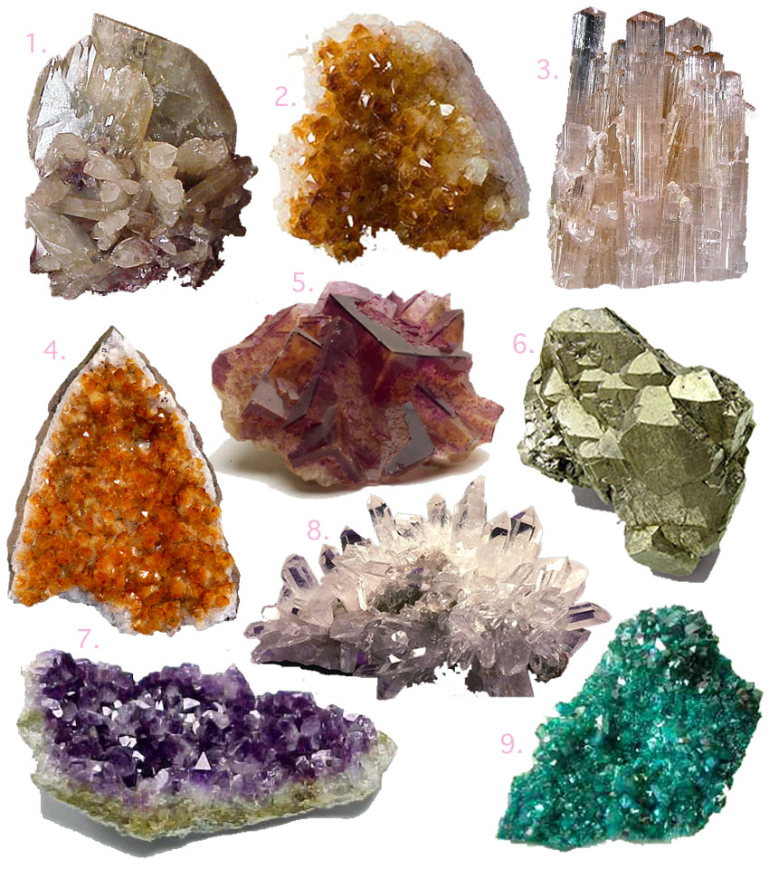
Minerals

Slide 3
Minerals
A mineral…
is naturally occurring
is solid
is inorganic
is representable by a chemical formula
has an ordered atomic structure
***is NOT the same as a rock

Slide 4
A mineral is naturally occurring.
Minerals may form in one of the following ways…
Molten Materials
(1) Cooling magma below the ground
(2) Cooling lava above the ground
Solutions
(3) Evaporation above the ground
(4) Veins below the ground
http://www.youtube.com/watch?v=TYvye0CVbU0

Slide 5
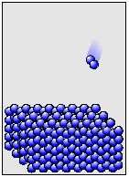
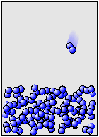
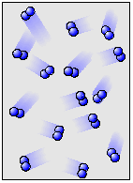
A mineral is a solid.
Solid when placed in normal conditions
Definite shape
Definite volume

Slide 6
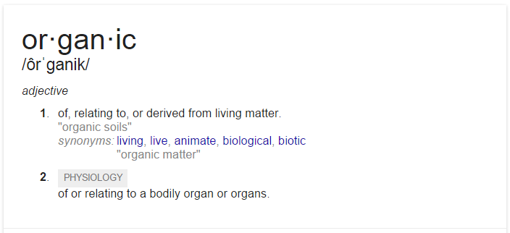
A mineral is inorganic.
So inorganic means…?

Slide 7
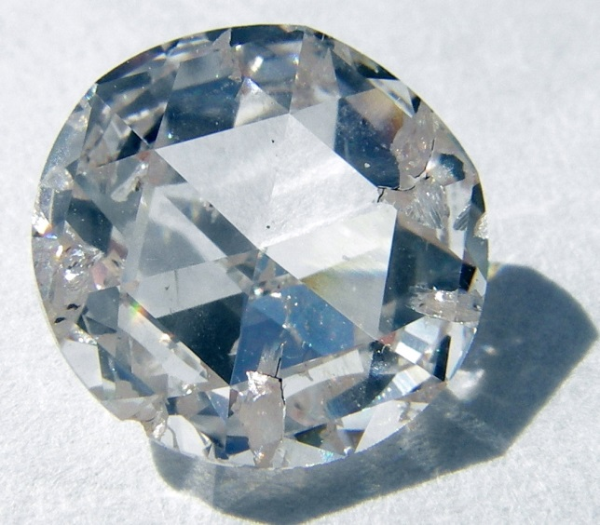
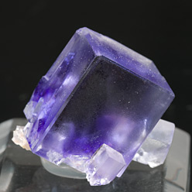
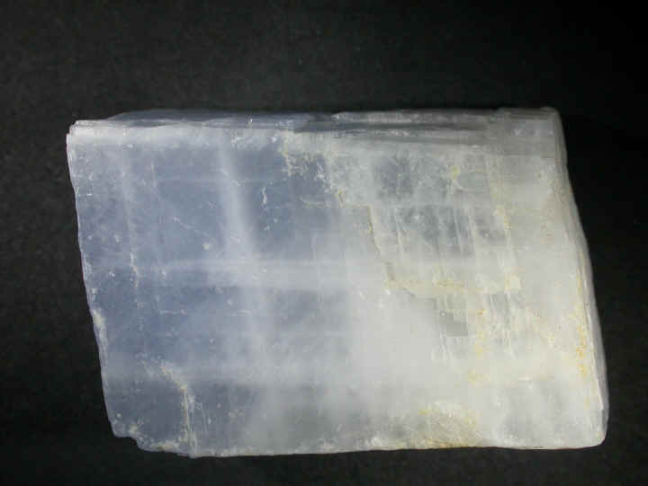
A mineral is representable by a chemical formula.
Calcite (CaCO₃)
Fluorite (CaF₂)
Diamond (C)

Slide 8
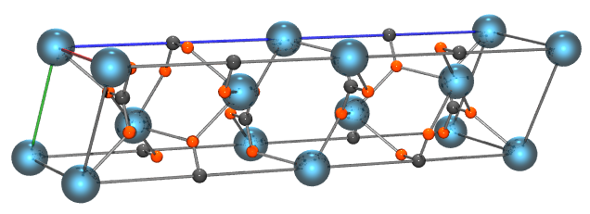
A mineral has an ordered atomic structure.
Calcite (CaCO₃)

Slide 9
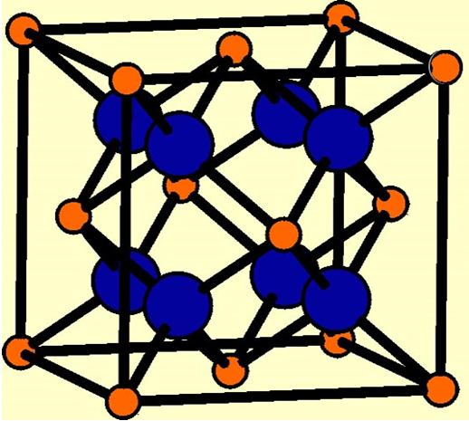
A mineral has an ordered atomic structure.
Fluorite (CaF₂)

Slide 10
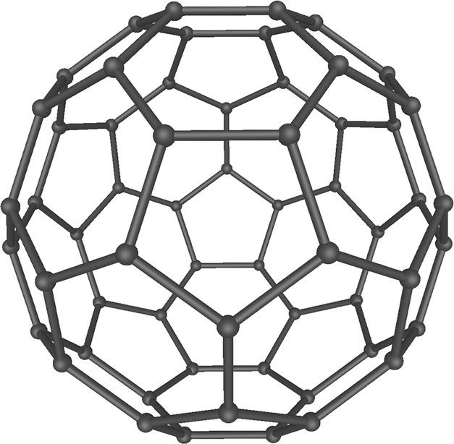
A mineral has an ordered atomic structure.
Diamond (C)

Slide 11
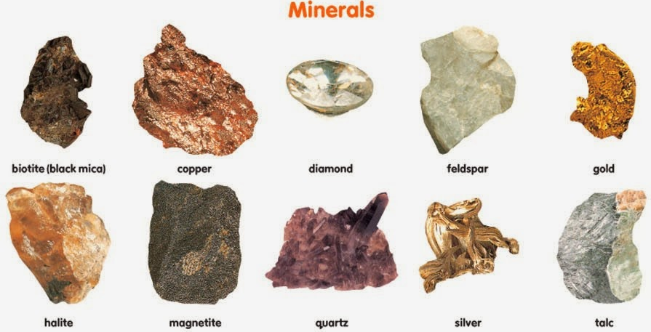
A mineral is NOT the same as a rock.

Slide 12
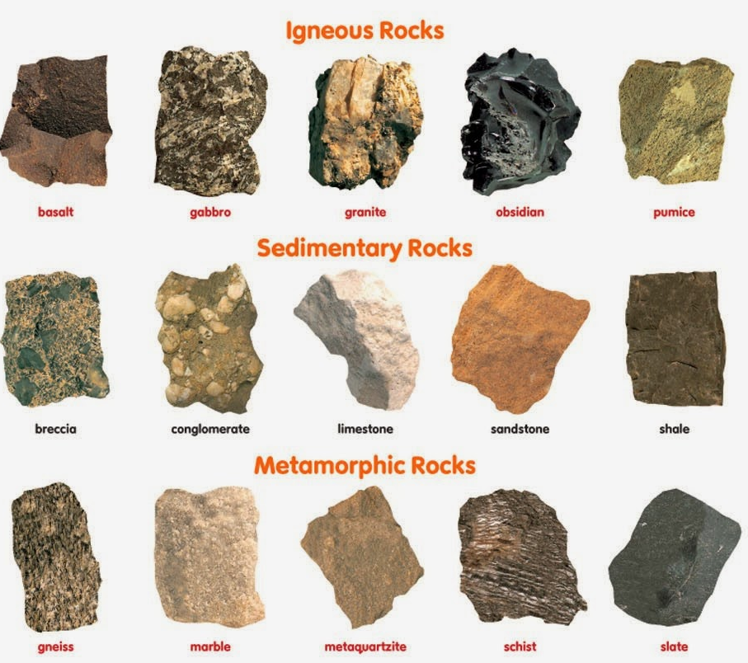
A mineral is NOT the same as a rock.

Slide 13
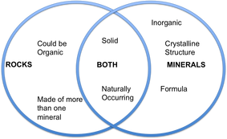
A mineral is NOT the same as a rock.

Slide 14
Test Yourself…
Mineral or Not?

Slide 15
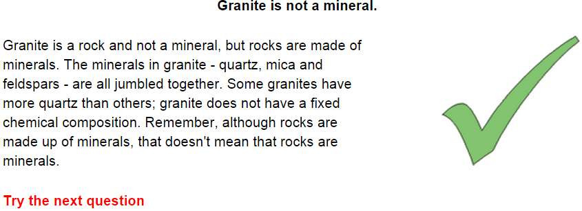
Test Yourself…
Mineral or Not?

Slide 16
Test Yourself…
Mineral or Not?

Slide 17
Test Yourself…
Mineral or Not?

Slide 18
Mineral Formation
Minerals may form in one of the following ways…
Molten Materials
Magma below the ground
Lava above the ground
Solutions
Evaporation above the ground
Veins below the ground

Slide 19
Mineral Formation
Mineral formation depends on:
What atoms are available in the surrounding area
How fast atoms can migrate to the crystal
Temperature and pressure in the surrounding environment
Slower cooling allows for larger crystals
Different minerals crystalize from the same solution at different temperatures
Pressure conditions must be just right for mineral formation

Slide 20
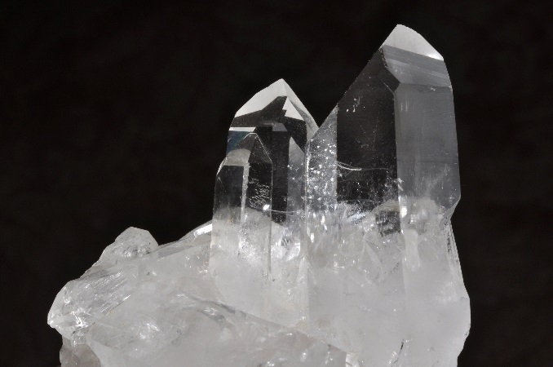
Mineral Formation
Minerals can indicate the type of environment in which the minerals formed.
For example…
Quartz (SiO₂) formed from molten rock.

Slide 21
Mineral Formation
Quartz (SiO₂) formed from molten rock.
What does this tell us about the environment in which it was formed?
Formed in an environment with volcanic activity (past or present)
Formed in an environment with silica-rich soil (and oxygen)

Slide 22
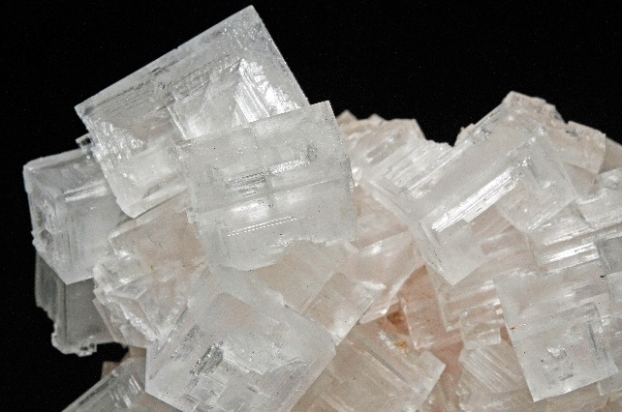
Mineral Formation
Halite (NaCl) formed from evaporation.
What does this tell us about the environment in which it was formed?
Formed in an environment rich in sodium and chlorine
Formed near/under dried up bodies of water

Slide 23
Entrance Question
One-Word Summary:
Write ONE word to represent minerals and the information learned yesterday. *Your word may NOT be mineral.*
Then use complete sentences to explain your thinking.
Be prepared to share.
You have another new Learning Target today!

Slide 24
Yesterday we learned…
A mineral…
is naturally occurring
is solid
is inorganic
is representable by a chemical formula
has an ordered atomic structure
is NOT the same as a rock

Slide 25
Mineral Properties
Minerals have specific properties that can be used for identification.
The properties that can be used for testing minerals include:
- color - streak
- luster - hardness
- crystal form - cleavage
- magnetism - acid reaction

Slide 26
Mineral Properties
Minerals have specific properties that can be used for identification.
What causes minerals to have different physical properties?
Their internal arrangement of atoms

Slide 27
Today’s Tasks
Assign groups and one mineral property
Read about your assigned mineral property. Combine and summarize your two sources.
Actively read by highlighting important details.
Share your highlighted details. Choose the 5 most important details.
Paraphrase your details on a piece of notebook paper.
Check with me before moving on to the next step.
Analyze your mineral set for one or more clear examples of your property. Be prepared to demonstrate.
Transfer your details to the slideshow linked to my website. Be prepared to share roles when presenting material.

Slide 28
Active Reading Use context clues to interpret unknown words!
Crystals are solid material in which the atoms are arranged in regular geometrical patterns. The crystal shape is the external expression of the mineral's regular internal atomic structure. Temperature, pressure, chemical conditions and the amount of space available are some of the things that affect their growth. Many crystallize from watery solutions, some from molten rock as during volcanic eruptions when lava cools rapidly.

Slide 29
Active Reading Highlight important details while reading your sources.
Crystals are solid material in which the atoms are arranged in regular geometrical patterns. The crystal shape is the external expression of the mineral's regular internal atomic structure. Temperature, pressure, chemical conditions and the amount of space available are some of the things that affect their growth. Many crystallize from watery solutions, some from molten rock as during volcanic eruptions when lava cools rapidly.

Slide 30
Active Reading Highlight important details while reading your sources.
Crystals are solid material in which the atoms are arranged in regular geometrical patterns. The crystal shape is the external expression of the mineral's regular internal atomic structure. Temperature, pressure, chemical conditions and the amount of space available are some of the things that affect their growth. Many crystallize from watery solutions, some from molten rock as during volcanic eruptions when lava cools rapidly.

Slide 31
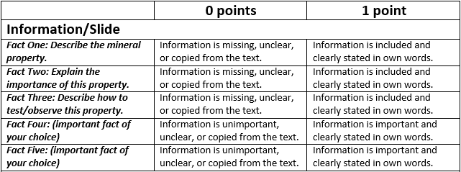
Once you have finished reading and highlighting, share your details and choose the 5 most important details to write on a piece of notebook paper.
Be sure to follow the rubric!

Slide 32
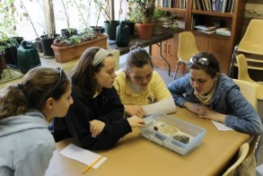
Mineral Property Demonstration
Expectations
Look for the BEST example.

Slide 33
Demonstration and Short Presentation
Transfer your details to your appropriate slide linked to halewms.weebly.com
Be sure to follow the rubric!

Slide 34
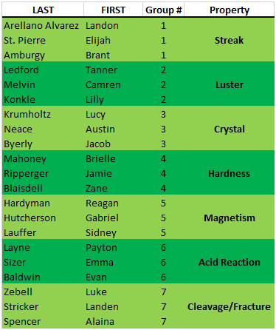
3rd Period

Slide 35
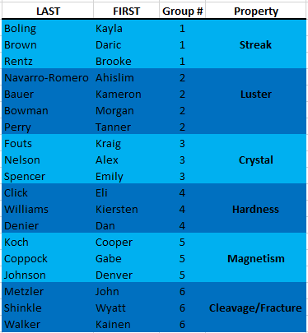
4th Period

Slide 36
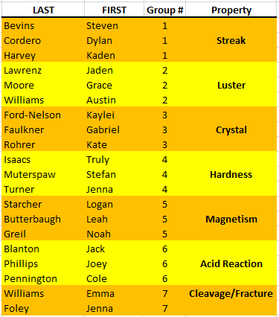
5th Period

Slide 37
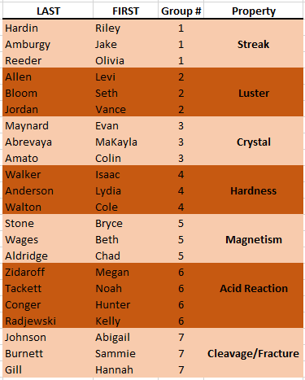
6th Period

Slide 38
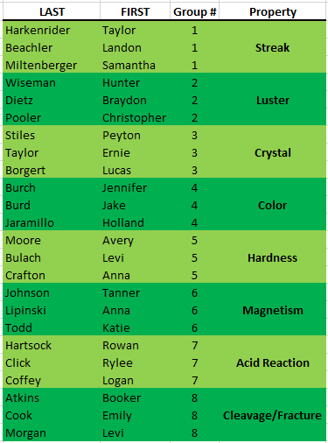
7th Period

Slide 39
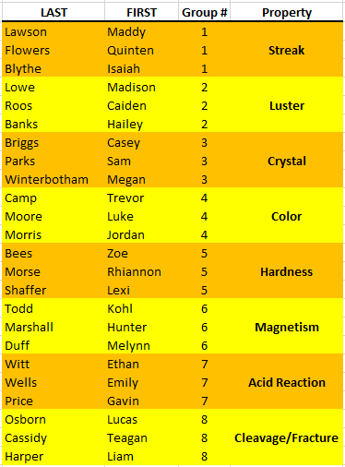
8th Period

Slide 40
Today’s Tasks
Assign groups and one mineral property
Read about your assigned mineral property. Combine and summarize your two sources.
Actively read by highlighting important details.
Share your highlighted details. Choose the 5 most important details.
Paraphrase your details on a piece of notebook paper.
Check with me before moving on to the next step.
Analyze your mineral set for one or more clear examples of your property. Be prepared to demonstrate.
Transfer your details to the slideshow linked to my website. Be prepared to share roles when presenting material.

Slide 41
Minerals
What is a mineral?

Slide 42
What is a mineral?
A mineral…
is naturally occurring
is inorganic
is a solid
is representable by a chemical formula
has an ordered atomic structure
What is the opposite of each of these?
Man-made, living, liquid/gas, random atomic structure and chemical composition

Slide 43
What is a mineral?
Minerals have specific properties that can be used for identification.
The properties that can be used for testing minerals include:
- color - streak
- luster - hardness
- crystal form - cleavage
- magnetism - acidic reactivity

Slide 44
What is a mineral?
Minerals have specific properties that can be used for identification.
What causes minerals to have different physical properties?
Their internal arrangement of atoms

Slide 45
Mineral Properties
Color
Color is the most noticeable physical property.
Color is a poor indicator.
Minerals can be multiple colors.
Many minerals are the same color.

Slide 46
Mineral Properties
Streak
Streak is the color of the powdered residue left when the mineral is scratched across a porcelain streak plate.
Some minerals’ powdered residue show a different color than the actual color of the mineral.

Slide 47
Mineral Properties
Luster
Luster is the way in which light reflects off of a mineral.
A mineral’s luster is typically categorized as metallic (like polished metal) or non-metallic (glossy, glassy, waxy, earthy, or pearly)

Slide 48
Mineral Properties
Hardness
Hardness refers to a mineral’s ability to scratch other materials or how the mineral resists scratching.
German mineralogist Friedrich Moh (1773-1839) established Moh’s Hardness Scale.
Moh’s Hardness Scale gives a number value to objects according to their tendencies to scratch and be scratched.

Slide 49
Mineral Properties
Crystal Form
Crystal form is the shape a crystal takes as it grows.
Crystal form is controlled by the mineral’s atomic structure. Shapes are created as atoms and molecules attach in specific ways.

Slide 50
Mineral Properties
Cleavage
Cleavage represents the tendency of a mineral to break in a specific direction along plane surfaces.
A mineral will break along atomic planes of weakness, repeating the flat surfaces on smaller broken pieces.

Slide 51
Mineral Properties
Fracture
Fracture surfaces represent non-planer, non-parallel surfaces in an uneven fashion.
When broken, smaller pieces will not repeat themselves.

Slide 52
Mineral Properties
Special Mineral Properties:
Magnetism
Magnets are attracted to the mineral.
Acid Reaction
Mineral will fizz when subjected to acid.

