Slide 1
Science Safety

Slide 2
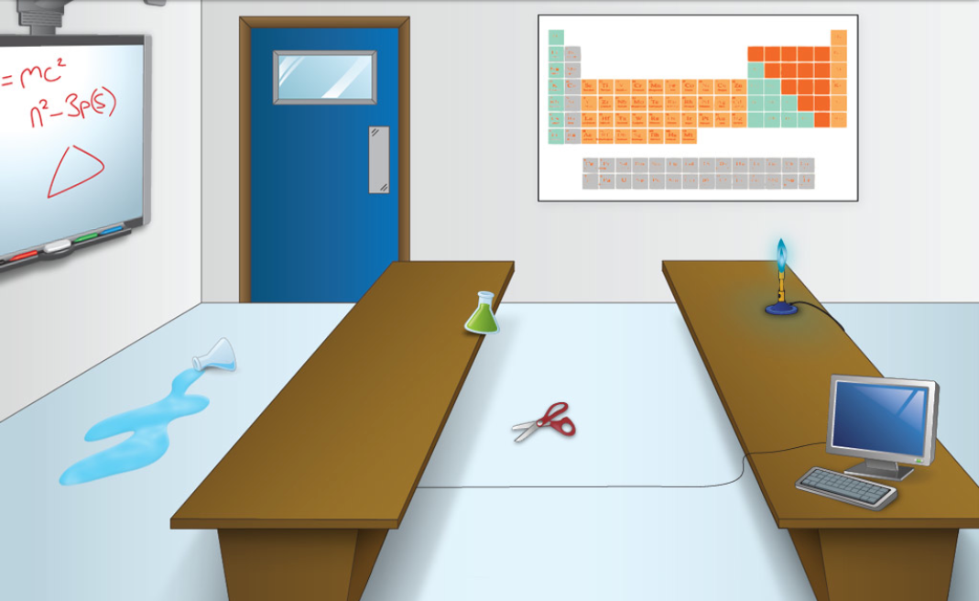
Look at the image below. Circle the object(s) or area(s) of the lab that are dangerous.

Slide 3
Safety Terms
biohazard – a risk to human health or the environment
corrosive – able to damage metal, stone, etc.
explosive – able to shatter or burst apart
flammable – easily set on fire
radioactive – emitting radiation
toxic - poisonous

Slide 4
Match the following chemical warning signs to the correct terms.
__ __ __ __ __ __ __ __
C A E G D F H B
A. Harmful E. Danger
B. Explosive F. Flammable
C. Toxic G. Corrosive
D. Biohazard H. Radioactive

Slide 5
To ensure safety during a lab, we need rules. Here are some important rules.

Slide 6
To ensure safety during a lab, we need rules. Here are some important rules.

Slide 7
To ensure safety during a lab, we need rules. Here are some important rules.

Slide 8
Lab Safety Assignment

