Slide 1
Tomorrow’s Quiz
Learning Targets:
I can recognize that all matter is made up of atoms.
I can describe the composition of substances in terms of elements and compounds.
I can explain the differences in elements, compounds, and mixtures.

Slide 2
Tomorrow’s Quiz
Study:
Elements, Compounds, & Mixtures Notes
Elements, Compounds, & Mixtures Worksheet
Yesterday’s assignment

Slide 3
Elements, Compounds, & Mixtures Review Games
Game One: Guess Who?
Game Two: Two Truths and a Lie
Game Three: Team Talk

Slide 4
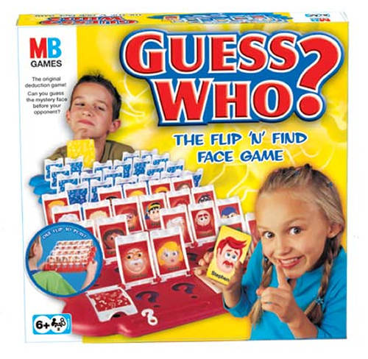
Element Guess Who?
Element
Na

Slide 5
Rules
One team may ask one question at a time.
Teams may only ask yes/no questions.
Questions must include the words protons, neutrons, electrons, or atomic mass.
The class may ask only three questions about each term above.
Once the answer is given, teams have 5 seconds to provide their guess before the next team is allowed to ask a question.
The team to guess the correct element first wins a point for that round.

Slide 6
Round One
K
?
___ Proton ___ Neutron
___ Proton ___ Neutron
___ Proton ___ Neutron
___ Electron ___ Atomic Mass
___ Electron ___ Atomic Mass
___ Electron ___ Atomic Mass
Notes:
K: 19p, 19e, 20n, mass of 39

Slide 7
Round Two
Cr
?
___ Proton ___ Neutron
___ Proton ___ Neutron
___ Proton ___ Neutron
___ Electron ___ Atomic Mass
___ Electron ___ Atomic Mass
___ Electron ___ Atomic Mass
Notes:
Cr: 24p, 24e, 28n, mass of 52

Slide 8
Round Three
Br
?
___ Proton ___ Neutron
___ Proton ___ Neutron
___ Proton ___ Neutron
___ Electron ___ Atomic Mass
___ Electron ___ Atomic Mass
___ Electron ___ Atomic Mass
Notes:
Br: 35p, 35e, 45n, mass of 80

Slide 9
Round Four
Ne
?
___ Proton ___ Neutron
___ Proton ___ Neutron
___ Proton ___ Neutron
___ Electron ___ Atomic Mass
___ Electron ___ Atomic Mass
___ Electron ___ Atomic Mass
Notes:
Ne: 10p, 10e, 10n, mass of 20

Slide 10
Round Five
Hg
?
___ Proton ___ Neutron
___ Proton ___ Neutron
___ Proton ___ Neutron
___ Electron ___ Atomic Mass
___ Electron ___ Atomic Mass
___ Electron ___ Atomic Mass
Notes:
Hg: 80p, 80e, 121n, mass of 201

Slide 11
On the Quiz:
Element | Protons | Neutrons | Electrons | Atomic Mass
Oxygen (O) | 8 |  |  | 16
Krypton (Kr) |  | 48 | 36
Argon (Ar) |  | 22 |  | 40

Slide 12
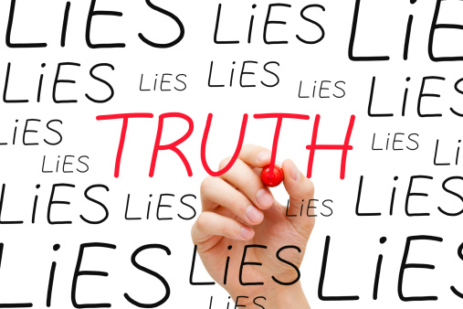
Two Truths and a Lie

Slide 13
Rules
Teams are given a group of three statements; two statements are true and one statement is false.
Teams must choose the “lie” from the group of statements.
In order to earn points, groups must rewrite the lie and make it true.

Slide 14
Round One
Mercury is a gas, therefore it is a mixture.
The air surrounding us is a mixture.
Carbon monoxide (CO) is a poisonous compound.

Slide 15
Round One
L
I
E
Mercury is a gas, therefore it is a mixture.
The air surrounding us is a mixture.
Carbon monoxide (CO) is a poisonous compound.

Slide 16
Round Two
A compound must include more than one kind of atom.
An element is the simplest pure substance.
A mixture is a pure substance.

Slide 17
Round Two
A compound must include more than one kind of atom.
An element is the simplest pure substance.
A mixture is a pure substance.
L
I
E

Slide 18
Round Three
Salt water has properties that are very similar to salt and water separately.
It is possible to break water down into simpler substances.
Water is a compound containing helium and oxygen.

Slide 19
Round Three
Salt water has properties that are very similar to salt and water separately.
It is possible to break water down into simpler substances.
Water is a compound containing helium and oxygen.
L
I
E

Slide 20
Round Four
Pepsi requires a chemical reaction to break it down into simpler substances.
Distillation, filters, and magnets are a few methods of separating a mixture.
Cobalt (Co) is an example of an element.

Slide 21
Round Four
L
I
E
Pepsi requires a chemical reaction to break it down into simpler substances.
Distillation, filters, and magnets are a few methods of separating a mixture.
Cobalt (Co) is an example of an element.

Slide 22
Round Five
Atoms are the building blocks of matter.
The smallest particle of an element with properties of that element is a molecule.
One molecule of water contains three atoms.

Slide 23
Round Five
Atoms are the building blocks of matter.
The smallest particle of an element with properties of that element is a molecule.
One molecule of water contains three atoms.
L
I
E

Slide 24
Team Talk

Slide 25
Rules
Questions are asked to one team at a time.
Teams must respond to the question in 20 seconds.
All team members must be involved in the team’s answer, each member saying one word at a time until the explanation is finished.
Groups may NOT write down their answers!
If a team gives an incorrect or unclear answer, questions may be stolen.

Slide 26
Question One
End
1
2
3
4
5
6
7
8
9
10
11
12
13
14
15
16
17
18
19
20
In terms of atoms/elements, explain how carbon monoxide (CO) and carbon dioxide (CO₂) are different AND how they are alike.

Slide 27
Question Two
End
1
2
3
4
5
6
7
8
9
10
11
12
13
14
15
16
17
18
19
20
Glucose (C₆H₁₂O₆) has how many more atoms of hydrogen (H) than carbon (C) atoms? Explain your answer.

Slide 28
Question Three
End
1
2
3
4
5
6
7
8
9
10
11
12
13
14
15
16
17
18
19
20
In terms of atoms/elements, explain how sulfur dioxide (SO₂) and carbon dioxide (CO₂) are different AND how they are alike.

Slide 29
Question Four
End
1
2
3
4
5
6
7
8
9
10
11
12
13
14
15
16
17
18
19
20
Ethanol (C₂H₆O) has six times as many atoms of hydrogen than what element? Explain your answer.

Slide 30
Question Five
End
1
2
3
4
5
6
7
8
9
10
11
12
13
14
15
16
17
18
19
20
Is this image an example of an element, compound, or mixture? Explain your answer.

Slide 31
Question Six
End
1
2
3
4
5
6
7
8
9
10
11
12
13
14
15
16
17
18
19
20
Is this image an example of an element, compound, or mixture? Explain your answer.

Slide 32
Question Seven
End
1
2
3
4
5
6
7
8
9
10
11
12
13
14
15
16
17
18
19
20
Is this image an example of an element, compound, or mixture? Explain your answer.

Slide 33
Question Eight
End
1
2
3
4
5
6
7
8
9
10
11
12
13
14
15
16
17
18
19
20
Is this image an example of an element, compound, or mixture? Explain your answer.

