Slide 1
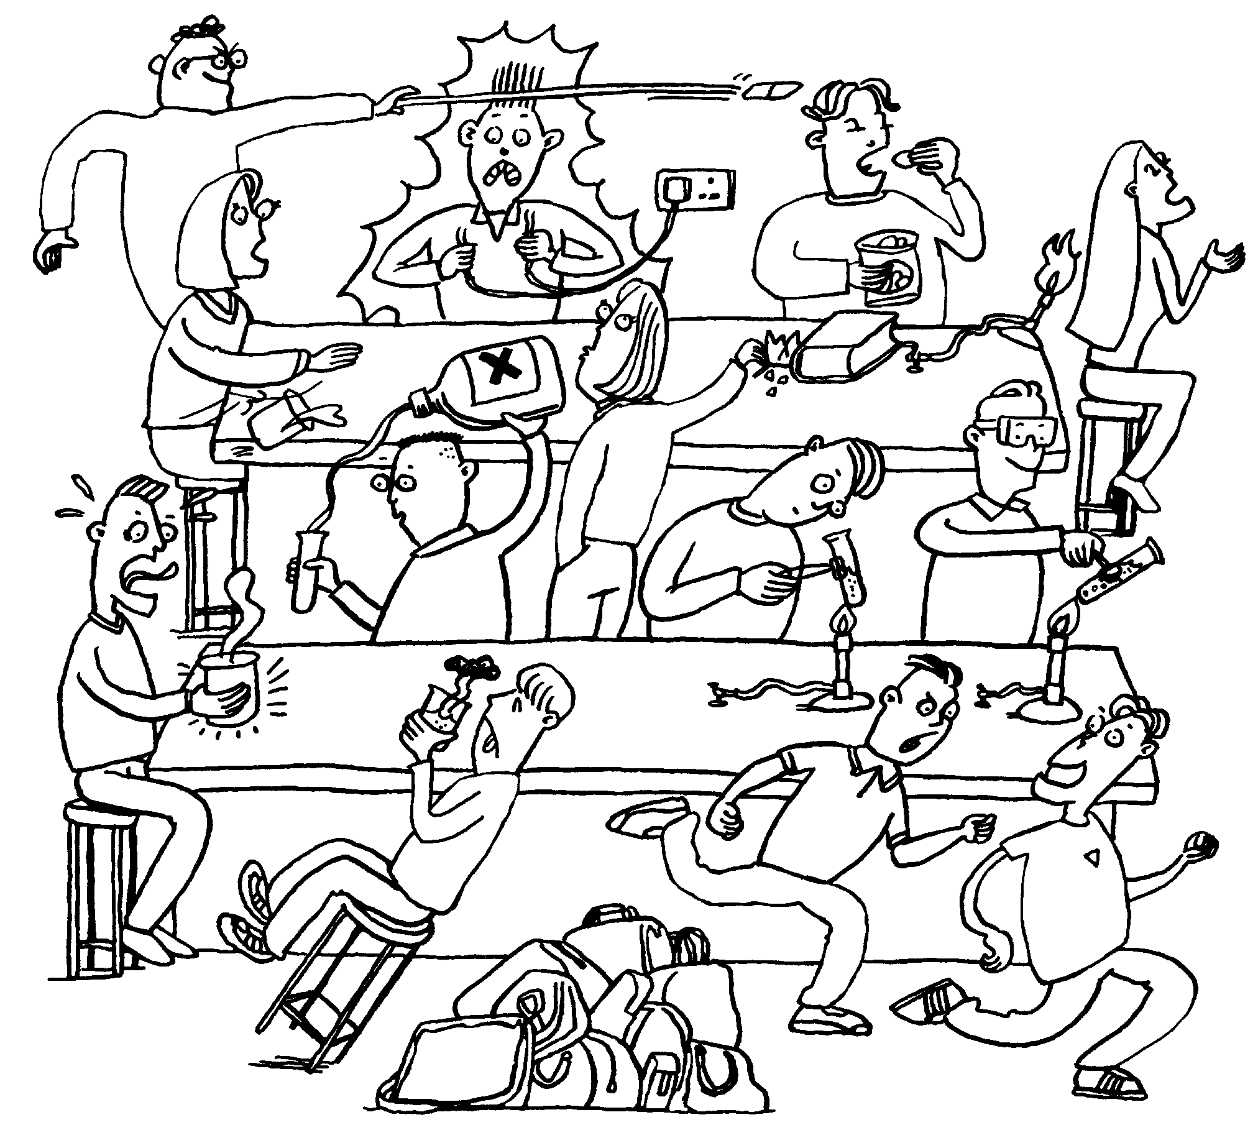
Entrance Question
Betty
Bill
Ben
Bo
Beth
Describe three situations in this picture where the students are breaking our science safety rules.
Sue
Joe
Rob
Al
Sam
Tom
Tim
Roy

Slide 2
Measurement

Slide 3
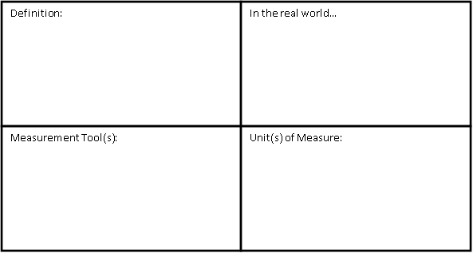
Mass
the amount of matter in an object
Triple beam balance
Digital balance
Grams (cg, kg, etc.)

Slide 5
Length
the distance between two points
Meter stick
Ruler
Tape measure
Meters (mm, cm, km, etc.)

Slide 7
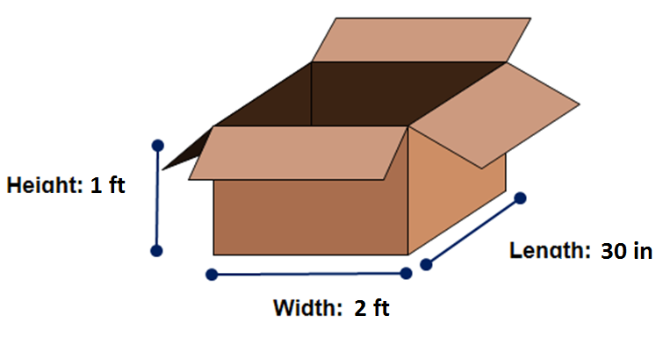
Entrance Question
Find the volume of the box below. Be sure to label your answer.

Slide 8
Volume
the amount of space that a substance or object occupies, or that is enclosed within a container
Graduated cylinder
Beaker
Meter stick/ruler
Liters (mL, kL, etc.)
Cubic meters (cm³, mm³, etc.)

Slide 9
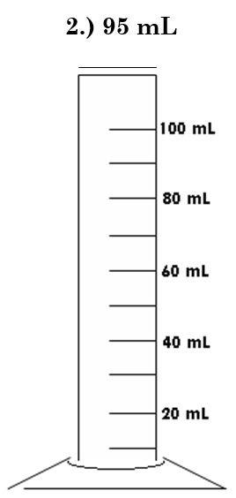

Slide 10
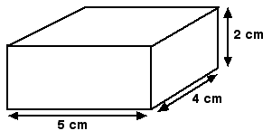

Slide 11
Measurement Lab
Length Scavenger Hunt
Mass Practice
Volume Practice
(You do NOT have to go in this order.)

Slide 12
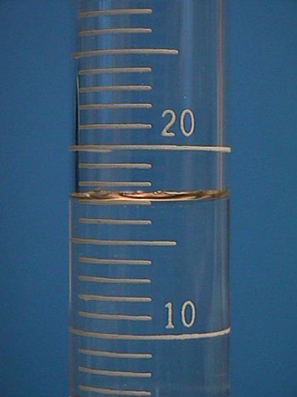
Entrance Question
What is the volume of this liquid?
____mL
If you dropped a nickel in this graduated cylinder and the water level now reads 20 mL, what is the nickel’s volume?

Slide 13
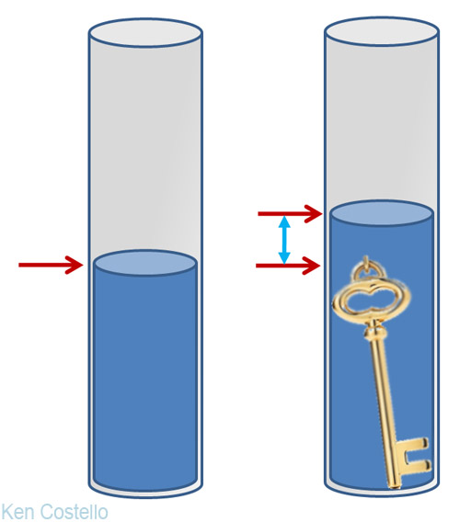
Water Displacement
This method helps us find the volume of objects that are irregular in shape.

Slide 14
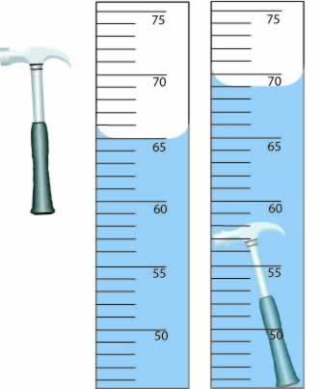
Water Displacement
Step 1: Find the volume of the water.
Step 2: Carefully submerge object in the water.
Step 3: Find the volume of the water and object.
Step 4: Subtract the water’s volume from the volume of the water and object.

Slide 15
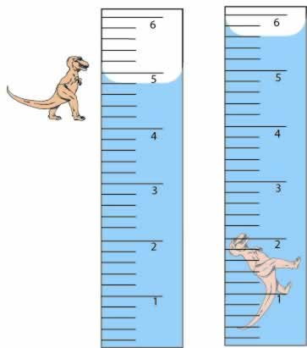
Water Displacement
Step 1: Find the volume of the water.
Step 2: Carefully submerge object in the water.
Step 3: Find the volume of the water and object.
Step 4: Subtract the water’s volume from the volume of the water and object.

Slide 16
Water Displacement Worksheet

