Slide 1
Entrance Question
Describe and explain at least one way in which mitosis occurred during your Thanksgiving break.

Slide 2
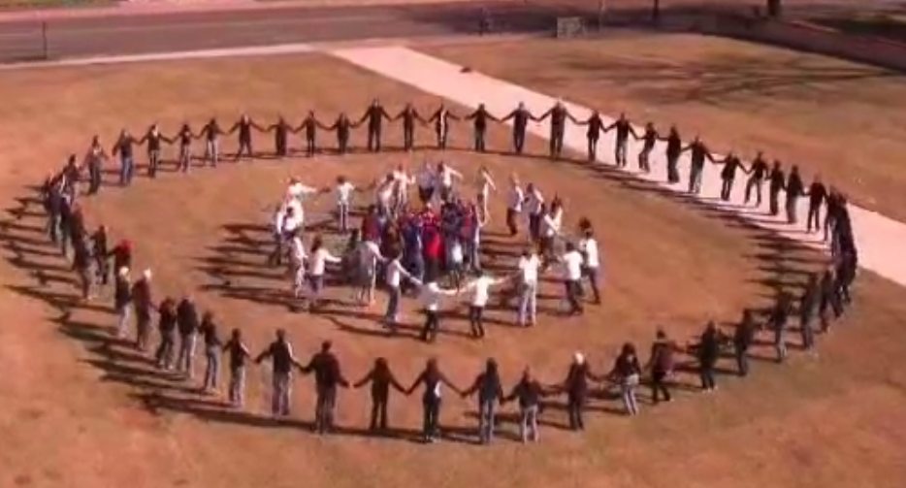
Baylor University Class Project
https://www.youtube.com/watch?v=ZEwddr9ho-4

Slide 3
Why might they have created this video?

Slide 4
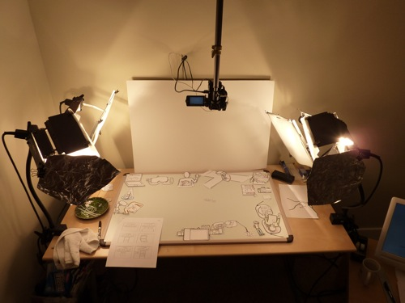
Cells & Mitosis Common Craft Videos

Slide 5
What is a common craft video?
http://www.youtube.com/watch?v=oCl1zoxs3Zo

Slide 6
Project Overview
Groups will create videos covering the following content:
I can summarize the cell theory.
I can demonstrate and explain how cells divide.
I can explain the purposes of cell division.
Groups will follow these steps:
Write a script
Create props
Rehearse
Film

Slide 7
Project Options
Option 1: Tell a story from the perspective of the cell.
Option 2: Tell a story from the perspective of a chromosome.
Option 3: Provide information in a format similar to a documentary.

Slide 8
Project Requirements
Script and props must adequately cover each learning target.
Video must be at least 2 minutes long.
All group members must share duties leading up to the filming (writing script, prop making, etc.).
Each group member must have his or her own filming duty:
Filming
Script reader(s)
Prop manager(s)

Slide 9
Grading
Summarize the cell theory
0 - - - - - - - - - - - - - - - - - - - - - - - - - - - 4
Not at all Completely
Demonstrate and explain how cells divide
0 - - - - - - - - - - - - - - - - - - - - - - - - - - - 4
Not at all Completely
Explain the purposes of cell division
0 - - - - - - - - - - - - - - - - - - - - - - - - - - - 4
Not at all Completely
Video Length of 2 minutes or more
0 (no), 4 (yes)

Slide 10
Grouping
Each group should include 2 orange and 2 black.

