Slide 1
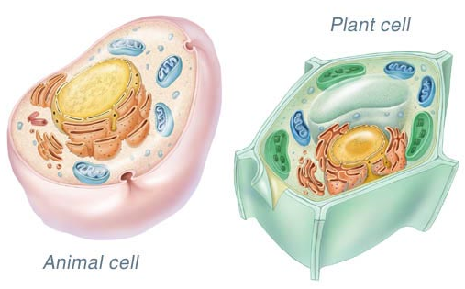
I see ______________________________________________________.
I think ____________________________________________________.
I wonder __________________________________________________.

Slide 2
Animal Cells

Slide 3
K W L
Animal Cells
What do you know? What do you want to know? What did you learn?

Slide 6
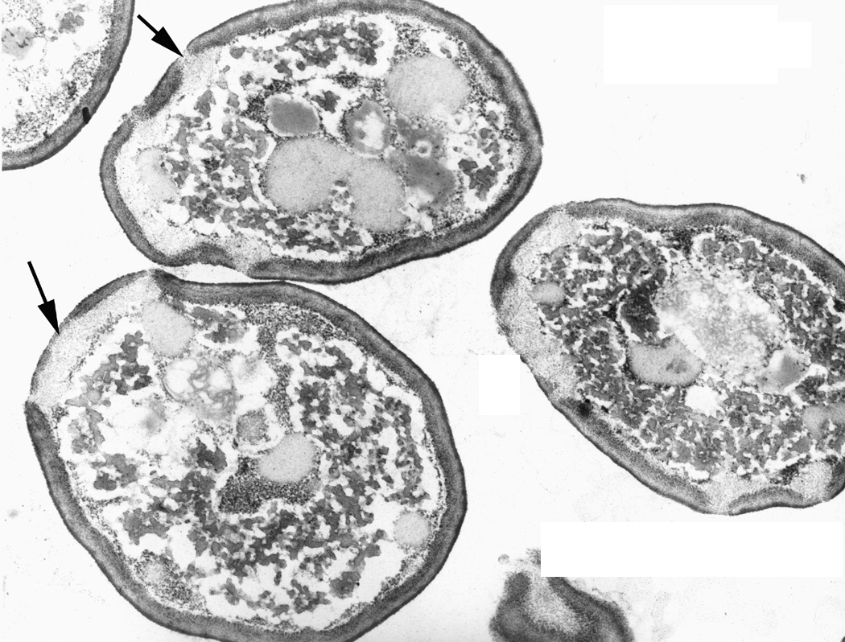

Slide 7
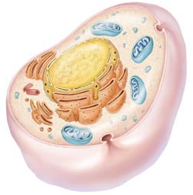
What do MOST animal cells have in common?
Most animal cells have rounded edges and contain similar organelles.

Slide 8
Parts of the Animal Cell
Organelle:
Tiny structure in the cytoplasm of a cell that performs a special job
Analogy:
Our body requires organs to do their jobs. A cell requires organelles to do their jobs.

Slide 10
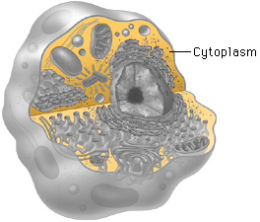
Parts of the Animal Cell
Cytoplasm:
Clear, jelly-like material that fills the space between the cell membrane and the nucleus
Analogy:
When making fruit jello, the jello keeps the pieces of fruit in place. The cytoplasm is like the jello of fruit jello.

Slide 12
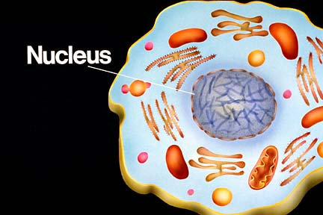
Parts of the Animal Cell
Nucleus:
Part of the cell that controls activities of other cell parts
Analogy:
A boss tells a worker what to do. The nucleus is the boss of the workers inside a cell.

Slide 13
(w/ chromosomes)

Slide 14
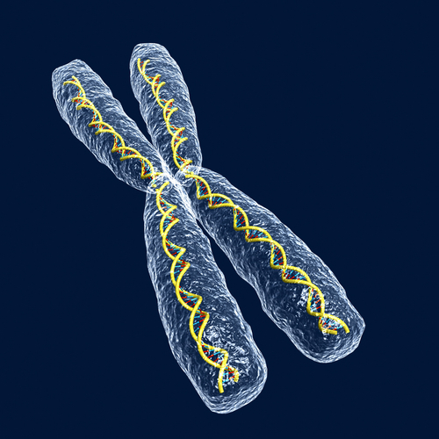
Parts of the Animal Cell
Chromosome:
String-like structure in a cell nucleus that carries information controlling all the cell’s activities
Analogy:
A company may print instruction manuals containing valuable information about the company’s activities. The chromosomes are like the cell’s instruction manuals.

Slide 16
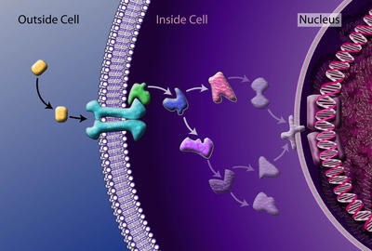
Parts of the Animal Cell
Cell membrane:
Thin outer covering that holds a cell together
Analogy:
Border control is responsible for protecting the border of the country and deciding who can enter and exit. The cell membrane is the border control of the cell.

Slide 18
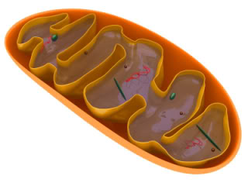
Parts of the Animal Cell
Mitochondria:
Organelles where food and oxygen react to release energy
Analogy:
Power plants make energy for a city. The mitochondria is a cell’s power plant.

Slide 20
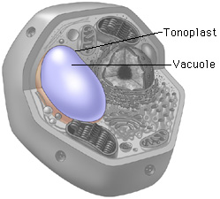
Parts of the Animal Cell
Vacuole:
Sac-like organelle used for storing materials
Analogy:
A pantry stores food and water inside a house. The vacuole is the pantry of a cell.

Slide 22
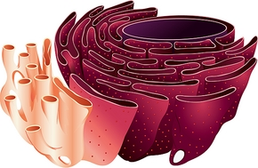
Parts of the Animal Cell
Endoplasmic Reticulum (ER):
Organelle that transports materials inside the cell
Analogy:
A subway must travel through underground tunnels to get from one place to another. The ER is the cell’s subway tunnels.

Slide 23
ribosome

Slide 24
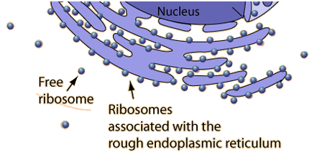
Parts of the Animal Cell
Ribosome:
Organelle that puts together proteins for the cell
Analogy:
A construction worker’s job is to build or construct. A cell’s ribosomes are like construction workers.

Slide 26
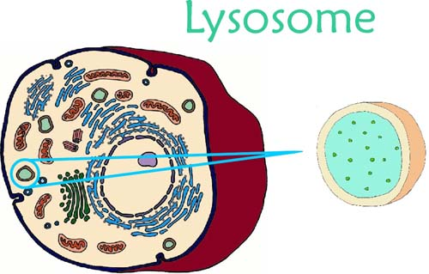
Parts of the Animal Cell
Lysosome:
Organelle that digests food and breaks down the dead cell
Analogy:
Large events require a clean-up crew to dispose of waste. The lysosomes are the clean-up crew of the cell.

Slide 28
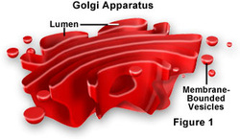
Parts of the Animal Cell
Golgi Complex (aka Golgi Apparatus or Golgi Bodies):
Organelle that packages and transports materials to other parts of the cell
Analogy:
You can send things off in packages using companies like Fed-Ex. The Golgi complex is cell’s Fed-Ex.

Slide 29
K W L
Animal Cells
What do you know? What do you want to know? What did you learn?

Slide 30
Textbook: A16 – A19
Write a paragraph to summarize each section within What Are the Parts of an Animal Cell.
There are two sections (Animal Cells & Functions of Cell Parts)
Paragraphs should have a topic sentence, three supporting details, and a closing sentence.

Slide 31
Plant Cells

Slide 32
K W L
Plant Cells
What do you know? What do you want to know? What did you learn?

Slide 33
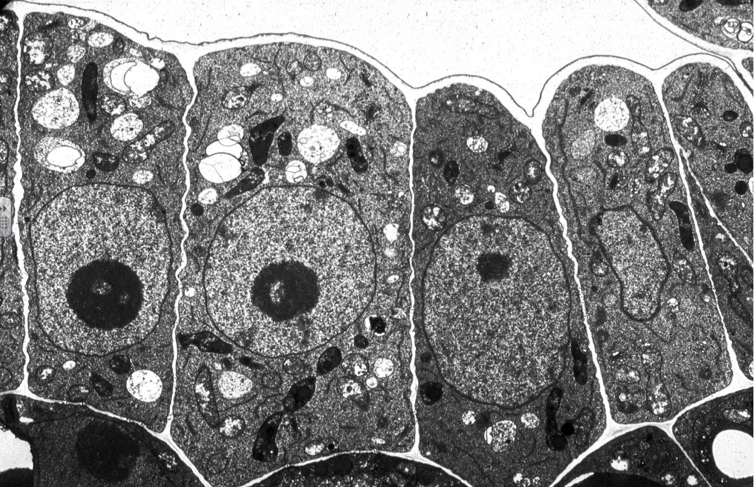

Slide 36
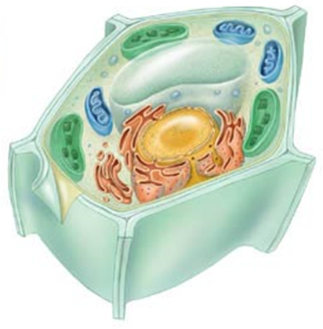
What do MOST plant cells have in common?
Most animal cells have rigid edges and contain similar organelles.

Slide 37
Textbook: A20 – A23
Read together.
“Popcorn”

Slide 38
Parts of the Plant Cell
Nucleus –
Part of the cell that controls activities of other cell parts
Cytoplasm –
Clear, jelly-like material that fills the space between the cell membrane and the nucleus
Vacuole –
Sac-like organelle used for storing materials
Endoplasmic Reticulum –
Organelle that transports materials inside the cell
Ribosome –
Organelle that puts together proteins for the cell

Slide 39
Parts of the Plant Cell
Mitochondria –
Organelles where food and oxygen react to release energy
Cell Membrane –
Thin outer covering that holds a cell together
Lysosome –
Organelle that digests food and breaks down the dead cell
Golgi Complex –
Organelle that packages and transports materials to other parts of the cell

Slide 40
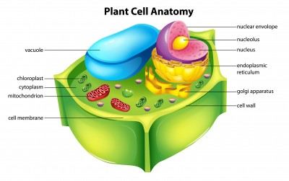

Slide 41
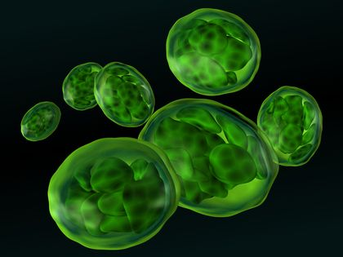
Parts of the Plant Cell
Chloroplast:
Organelle that makes sugars, using carbon dioxide, water, and the energy from the sunlight

Slide 42
(w/ chlorophyll)

Slide 43
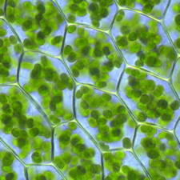
Parts of the Plant Cell
Chlorophyll: Green substance in the chloroplasts that traps energy from sunlight

Slide 45
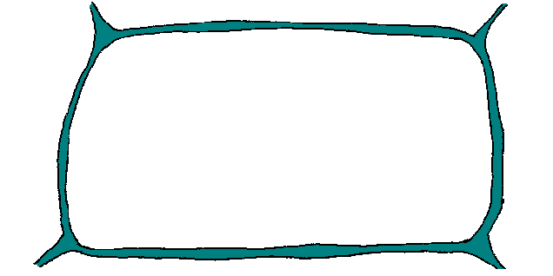
Parts of the Plant Cell
Cell Wall:
Tough, nonliving material that acts like an outside skeleton for each plant cell

Slide 46
