Slide 1
Entrance Question
Critique the following student’s work. Explain his or her mistake(s).
Directions: Identify each statement as a qualitative observation (QL), quantitative observation (QN), or inference (I).
QL 1. The bird has two eyes.
QN 2. The bird is blue.
QL 3. The bird is frightened.

Slide 2
The Scientific Method

Slide 3
Scientific Questions
A good scientific question can be answered by a direct observation and not by an opinion.
Good scientific questions are very specific.
Examples:
Does Tide or CVS detergent remove ketchup stains better?
Do plants grow better with fertilizer or without fertilizer?
Do your fingers wrinkle faster in hot water or cold water?
Does water freeze faster with salt or without salt?

Slide 4
Scientific Questions
Most good scientific questions make a comparison with the word OR.
Some good scientific questions make a comparison with more than 2 items.

Slide 5
Scientific Questions
Which of the following are good scientific questions? YES or NO?
What do birds eat?
________________

Slide 6
Scientific Questions
Which of the following are good scientific questions? YES or NO?
Will plants grow taller when grown using white light or green light?
____________

Slide 7
Scientific Questions
Which of the following are good scientific questions? YES or NO?
Do athletes run faster with or without vitamins?
________________

Slide 8
Scientific Questions
Which of the following are good scientific questions? YES or NO?
How fast can humans run?
________________

Slide 9
Scientific Questions
Rewrite the two poorly written questions.
What do birds eat?
How fast do humans run?

Slide 10
Entrance Question

Slide 11
Hypothesis
A hypothesis is an educated guess about what will happen in your experiment.
Your hypothesis is based on prior knowledge or research.
You must be able to explain the reasoning for your hypothesis.

Slide 12
Hypothesis
Every hypothesis should follow this format:
If ________________, then ______________.
(If I do this…) (… then I think this will happen)
Example:
If I burn a candle under a large beaker and under a small beaker, then the candle will burn longer under the larger beaker.

Slide 13
Hypothesis
Write STRONG or WEAK by each hypothesis:
________ Mt. Dew will make a plant grow higher than water, milk, or Powerade
________ Plants given water will grow.
________ If people drink soda, then their teeth will decay more quickly than if they drink water.
(finish the rest on your own)

Slide 14
Hypothesis
Write a strong hypothesis for the following experiment:
Question: Will plants that are given fertilizer grow better than plants that are not?
(finish the rest on your own)

Slide 15
Entrance Question

Slide 16
Constants
A constant is something that you keep the same in your experiment.
There should be many constants in an experiment.
Example: When we test the strength of different brands of wet paper towels, the controls should be:

Slide 17
Variables
A variable is something that changes in an experiment in order to test a hypothesis.
The independent variable is the variable that is changed on purpose to test your hypothesis.
The dependent variable is the variable that changes as a result of the independent variable.
There should be one independent variable in an experiment.

Slide 18
Variables
Question: Do Brawny or Bounty paper towels absorb more water?
Independent:
Dependent:

Slide 19
Variables
Question: Does grass grow taller with Scotts fertilizer or the generic brand fertilizer?
Independent:
Dependent:

Slide 20
Review
Do cards get better gas mileage using regular or premium gas?
Independent Variable:
Dependent Variable:
Constants:

Slide 21
Entrance Question

Slide 22
Procedure
In a science experiment, the procedure is provided to give step-by-step instructions for how to carry out the experiment.
When writing your procedure, be brief but specific.
Your procedure should be written well enough that someone with less knowledge could duplicate your experiment.

Slide 23
Procedure
Label each sample procedure as STRONG or WEAK.
__________________
Step 1: Plant four plants in pots.
Step 2: Place two plants in dark places and two in bright places.
Step 3: Water the plants daily.
Step 4: Measure the plants.
Step 5: Record the data.

Slide 24
Procedure
__________________
Step 1: Plant four geraniums of the same size in four pots of the same size.
Step 2: Place two plants in a dark closet with no exposure to sunlight and place two plants near a window with plenty of sunlight. Do not move the plants for 7 days.
Step 3: Give each plant 2 cups of water per day.
Step 4: Using a ruler in centimeters, measure each plant daily. Each plant should be measured from the base of its stem to the top of its tallest point.
Step 5: Record the daily measurements in a table.
Step 6: Calculate the average plant height for the two plants with light and the two plants without light.

Slide 25
Procedure
What made one procedure better than the other?

Slide 26
Data Analysis
As you carry out the procedure of an experiment, you should always record your data.
This data should then be organized and analyzed to better understand your results.
This often involves creating tables and graphs to display the data.

Slide 27
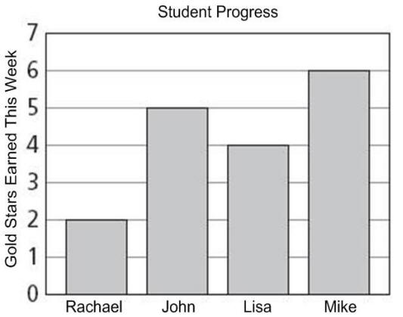
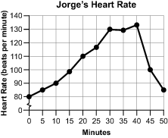
Data Analysis
The most common types of graphs used this year to display experimental data are bar graphs and line graphs.

Slide 28
Data Analysis
Bar graphs are best used when comparing two or more quantities.
Example: Speed is measured for the same runner using two different brands of shoes.

Slide 29
Data Analysis
Line graphs are best used when tracking a change in measurements over a period of time.
Example: Plant heights are measured throughout a week as they are given different amounts of sunlight.

Slide 30
Data Analysis
Label each scenario with BAR or LINE to tell which graph best displays the data.
_________________ Heart rate is measured every hour for a day in a stressful environment and for a day in a relaxing environment.
_________________ One sheet of four different brands of paper towels are tested to see how much weight they can hold before tearing.

Slide 31
Data Analysis
Label each scenario with BAR or LINE to tell which graph best displays the data.
_________________ Two different brands of golf balls are dropped from the same height to measure how high each ball bounces.
_________________ Weights of two puppies are measured each week for two months. One puppy is fed two small servings per day and one puppy is fed one large serving per day.

Slide 32
Conclusion
The conclusion wraps up an experiment.
The conclusion uses complete sentences and includes the following information:

Slide 33
Conclusion
1. It summarizes the results of the experiment.
2. It compares the results of the experiment to the hypothesis.
Ex: The results support my hypothesis.
OR
The results reject my hypothesis.
3. It provides suggestions or plans for further research and/or experimentation.

Slide 34
Conclusion
Label each sample conclusion as STRONG or WEAK.
_________________ After one week, the plant grew the most under the red light. This is what I thought would happen.

Slide 35
Conclusion
Label each sample conclusion as STRONG or WEAK.
_________________ The results of the experiment show that Kroger brand nail polish remover removes more finger nail polish than Cutex brand. These results reject my hypothesis, which said the name brand nail polish remover would work best. I plan to continue testing Kroger’s nail polish remover against other name brand products.

Slide 36
Conclusion
Label each sample conclusion as STRONG or WEAK.
_________________ The experiment revealed that nitrogen kept the balloon inflated 10 or more days longer than the other gases used to fill the balloons. This supports my hypothesis. It would be good to test the nitrogen inflated balloons in extreme temperatures next.

Slide 37
Conclusion
A student saw a commercial for Fertilizer X and decided to put it to the test against regular soil. He hypothesized that Fertilizer X would cause the plant to grow taller. After a week of measurements, the plant using Fertilizer X was the same size as the plant using regular soil.
What is the conclusion?

