Slide 1
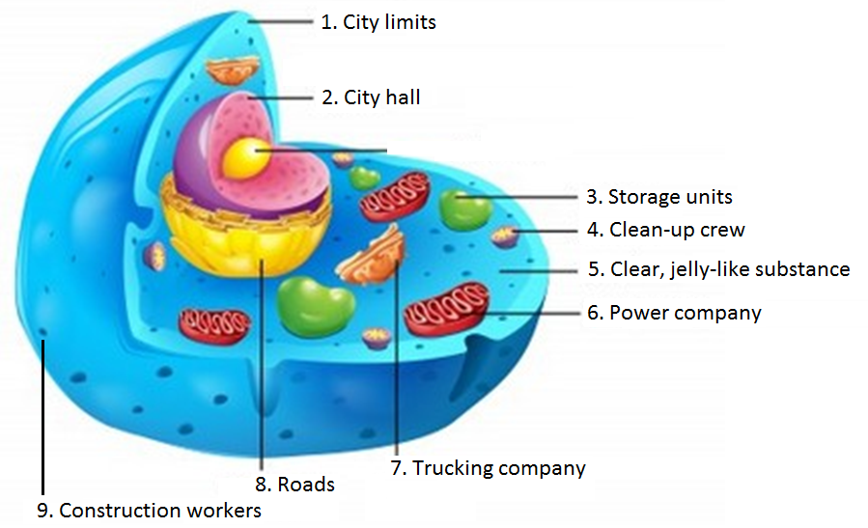
Entrance Question Identify parts 1-9 using the actual organelle name.
***Try NOT to use your notes.
Use the middle 9 terms on
word wall.

Slide 2
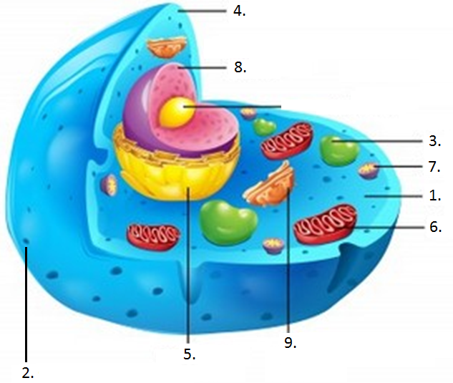
Practice makes perfect…

Slide 3
Animal Cell Projects
Individual Projects
3 Options
Cell model, cell rap, cell video
All projects will be presented to the class
20 possible points
Due Monday, December 15

Slide 4
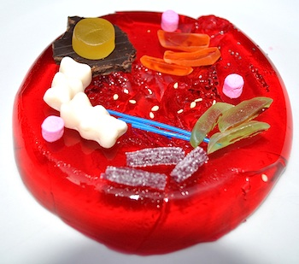
Option 1 Edible Animal Cell

Slide 5
Edible Cell Model Requirements
2 pts each
_____ Accurately model and label each part of
the animal cell mentioned in class
- Cell membrane
- Cytoplasm
- Nucleus
- Chromosome
- Endoplasmic reticulum
- Golgi complex
- Lysosome
- Ribosomes
- Mitochondria
- Vacuole
******************
Your cell model does NOT have to be edible.
******************
******************
Be prepared to tell what each cell part does during your presentation.
******************
20 points possible

Slide 6
Option 2 Animal Cell Parts Rap

Slide 7
Animal Cell Rap Requirements
2 pts each
_____ Accurately name and describe the role of
each animal cell part mentioned in class
- Cell membrane
- Cytoplasm
- Nucleus
- Chromosome
- Endoplasmic reticulum
- Golgi complex
- Lysosome
- Ribosomes
- Mitochondria
- Vacuole
20 points possible

Slide 8
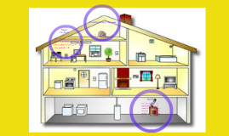
Option 3 Animal Cell Analogy Video or PowerPoint

Slide 9
Animal Cell Analogy Requirements
2 pts each
_____ Accurately name and compare the role of
each animal cell part to a building, etc.
- Cell membrane
- Cytoplasm
- Nucleus
- Chromosome
- Endoplasmic reticulum
- Golgi complex
- Lysosome
- Ribosomes
- Mitochondria
- Vacuole
******************
You can NOT do a Cell City analogy as completed in class.
******************
20 points possible

Slide 10
Today’s Goal:
3D Model:
- Make a list of the organelles and the materials you might be able to use to represent each one. Think of multiple materials as backups.
Cell Rap:
- Begin writing your lyrics/poems. Remember that each organelle must be mentioned along with their roles.
Cell Video:
- Begin thinking of your “cell.” What are the organelles? Put your thoughts down in writing. You could also begin writing a script that would be read during filming. Remember that an explanation must be given for each organelle.

Slide 11
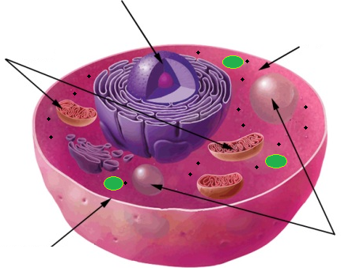
3
4
2
5
1
9
8
7
6

Slide 12
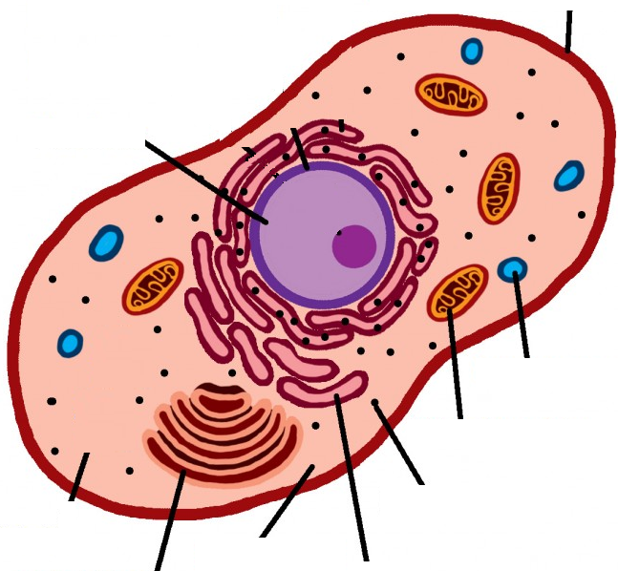
1
Match.
Power
Storage
Pack/Ship
Digest
Construct
Control
Protect
Pathways
Filler
9
2
3
4
8
6
7
5

