Slide 1
Soil

Slide 2
Weathering
Weathering is the wearing away of the surface of rock, soil, and minerals into smaller pieces.
Example: Wind and water cause small pieces of rock to break off at the side of a mountain.
Weathering can occur due to chemical and mechanical processes.

Slide 3
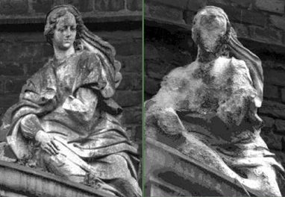
Weathering
Chemical weathering: Chemical reactions break down the bonds holding the rocks together.
Example: Caves are formed when carbonic acid (dissolved CO₂ + water) reacts with minerals in rocks
Smaller rocks are more likely to weather because they have more surface exposed.

Slide 4
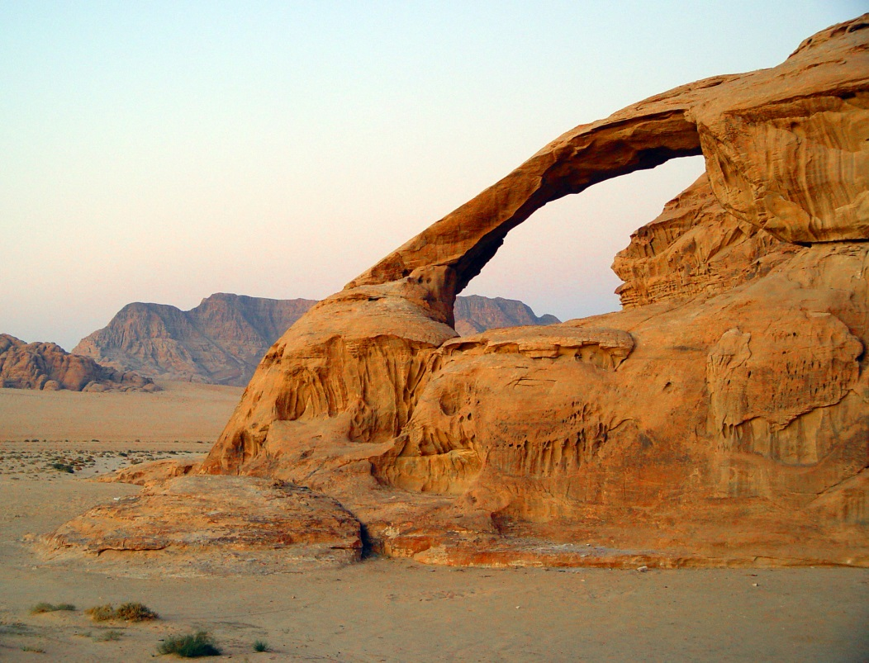
Weathering
Mechanical weathering: Rocks are torn apart by physical forces, rather than by chemical breakdown
Example: Earth’s crust slowly grinding/ colliding from great amounts of pressure

Slide 5
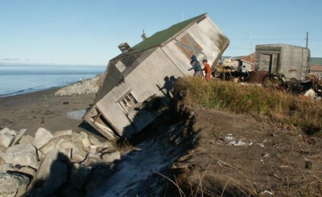
Erosion
Erosion is the movement of particles away from their source.
Example: Wind carries small pieces of rock away from the side of a mountain.
Transporting agents of erosion include water, wind, ice, and gravity.

Slide 6
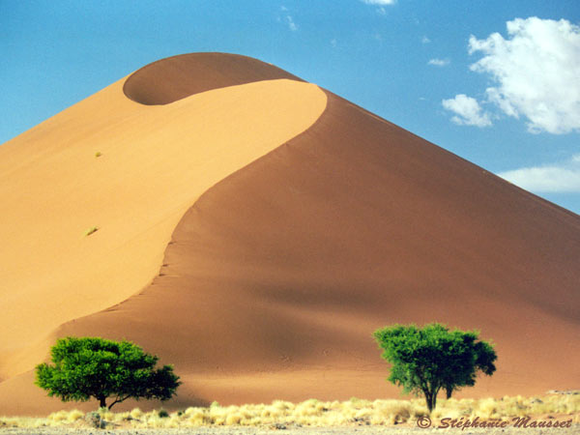
Erosion
Deposition is the process whereby particles are released by their transporting agents (dropped).

Slide 7
Soil: What is it?
Soils are complex mixtures of minerals, water, air, countless organisms, and other organic matter (he decaying remains of once-living things).
It forms at the surface of land – it is the “skin of the earth.” Soil is capable of supporting plant life and is vital to life on earth.

Slide 8
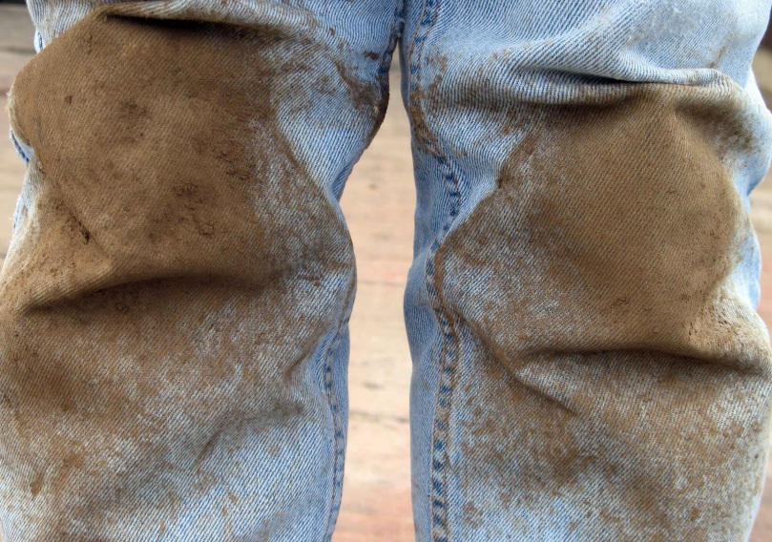
Soil: What is it?
Soil and dirt are not the same!
Dirt is what gets on our clothes or under our fingernails.
Dirt is soil that is out of place in our world – whether tracked inside by shoes or on our clothes.
Dirt is also soil that has lost the characteristics that give it the ability to support life – it is “dead.”

Slide 9
Soil Formation
http://www.youtube.com/watch?v=Fx8r3o2gsLk
What does this tell us about the formation of soil?

Slide 10
Soil Formation
It takes hundreds of years to form one centimeter of soil.
Soils are created from the weathering of parent material, either solid rock or sediments.
Parent material is the main factor responsible for the properties of the soil.

Slide 11
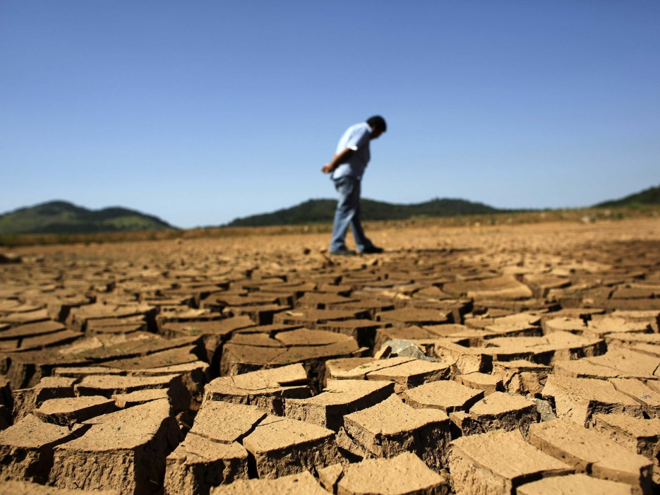
Soil Formation
Climate greatly affects soil formation.
Temperature, rainfall, snow, and ice all influence the way the parent materials are converted to soil.
Warm and wet climates are more likely to produce larger amounts of nutrient-rich soil.

Slide 12
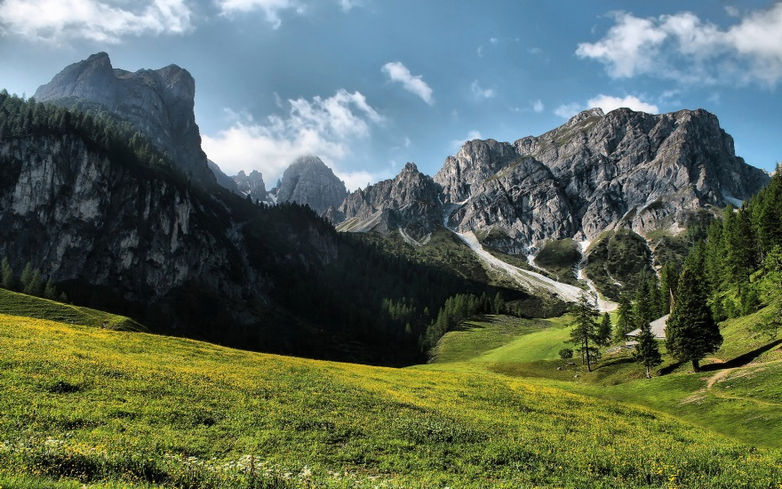
Soil Formation
Landscape influences the thickness of soil.
Steep slopes often have thin soil due to runoff as rain washes down the slopes.
Plains and valley floors tend to collect more sediment and produce more soil.

Slide 13
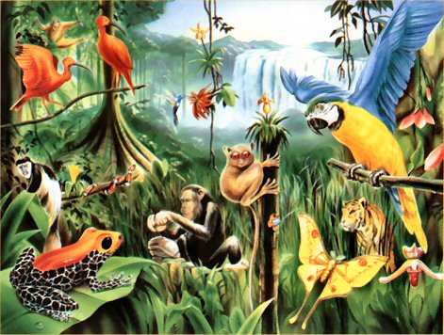
Soil Formation
Living things (vegetation and soil animals) are important in soil formation.
Plant cover acts to stabilize soils and prevent the erosion of soil.
Soil animals help to richen the soils with nutrients.

Slide 14
Soil Properties
Texture
Texture is the proportion of three mineral particles, sand, silt, and clay, in a soil.
The amount of each type of particle in a soil defines its texture.

Slide 15
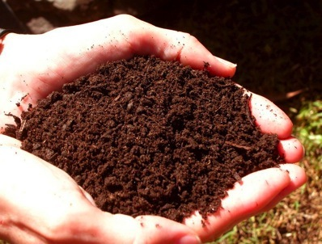
Soil Properties
Color
The color of soil indicates the minerals/materials in it. Here are a few examples:
Red soil: large amounts of iron
Dark soil: large amounts of decayed organic matter

Slide 16
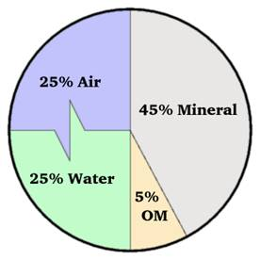
Soil Properties
Composition
Composition refers to the components that make up soil.
The basic components include minerals, organic matter, water, and air.
Typical soil consists of 45% mineral, 5% organic matter, 20-30% water, and 20-30% air.
These numbers vary greatly, depending on conditions in that specific location.

Slide 17
Soil Properties
Composition

Slide 18
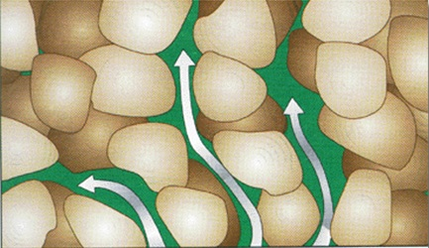
Soil Properties
Permeability
Permeability is the soil’s ability to hold water.
Impermeable soil allows low seepage (ex: clay)
Soils with high permeability tend to have large pores and a sandy texture, which allows water to seep through.

Slide 19
Soil Properties
Porosity
Porosity refers to the size of the pores (space between particles) in soils.
Larger coarse-textured soils have many large pores.
Fine-textured soils are more tightly arranged and have more small pores.

Slide 20
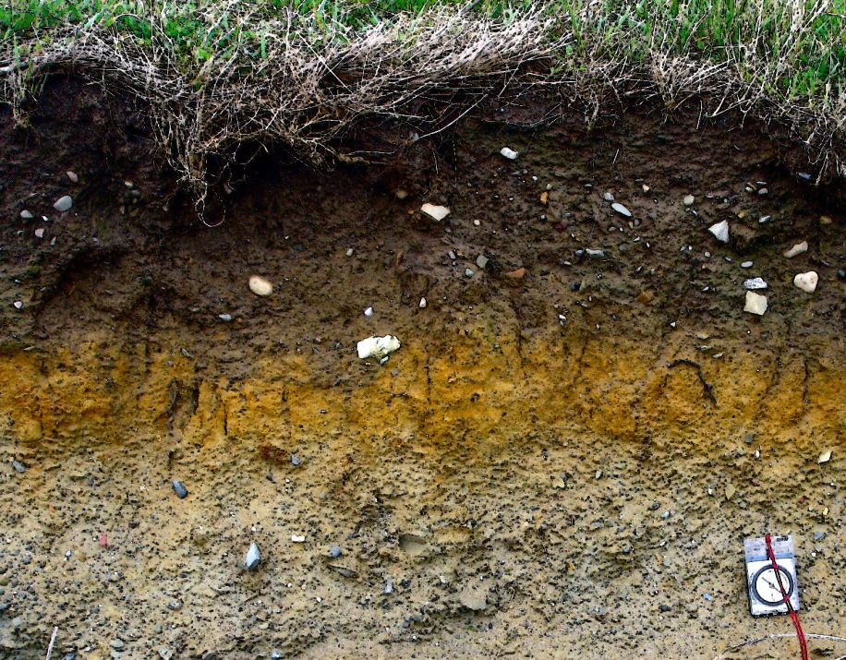
Soil Horizons
Soil is made up of distinct horizontal layers; these layers are called horizons.
They range from rich, organic upper layers to underlying rocky layers.

Slide 21
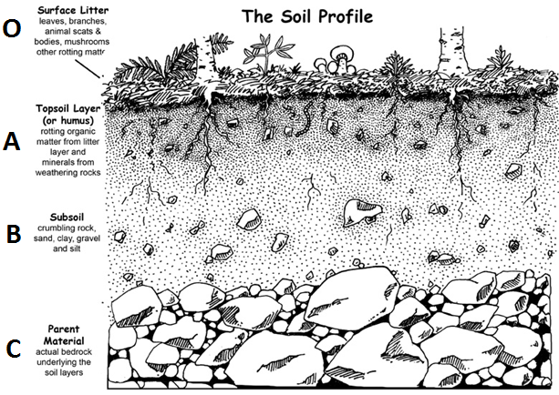
Soil Horizons

Slide 22
Soil Horizons
O Horizon:
The top, organic layer of soil, which is made up mostly of leaf litter and humus (decomposed organic matter).

Slide 23
Soil Horizons
A Horizon:
The dark layer of topsoil where seeds germinate and plant roots grow. It is made up of humus and mineral particles.

Slide 24
Soil Horizons
B Horizon:
This layer of subsoil contains clay and mineral deposits that it receives from layers above it when water travels down.

Slide 25
Soil Horizons
C Horizon:
The layer of slightly broken-up bedrock or unweathered bedrock where plant roots do not penetrate and very little organic material is found.

Slide 26
Recap
http://www.youtube.com/watch?v=egpyJtnKY6U

Slide 27
Uses of Geologic Resources
Rocks, minerals, and soil are examples of nonrenewable resources.
Rocks, minerals, and soils have specific physical properties that determine how they can be used.

Slide 28
Uses of Geologic Resources
Uses of the resources include:
Construction (e.g., gypsum, metals, gravel, sand, lime, clay)
Energy (e.g., fossil fuels, radioactive materials)
Transportation (e.g., road salt, asphalt)
Agriculture (e.g., lime, peat, minerals for fertilizers, pesticides)
Domestic use (e.g., metals and gems for jewelry, clay for pottery or sculpting, natural dyes for clothing or paint)
Technology (e.g., lithium, silica)

