Slide 1
States of Matter

Slide 2
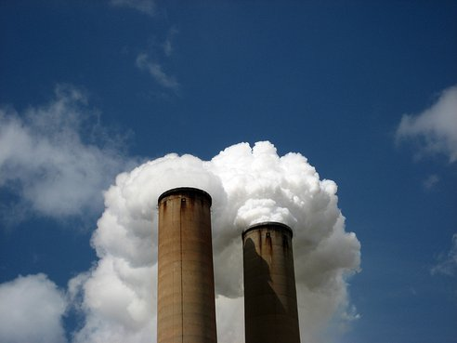
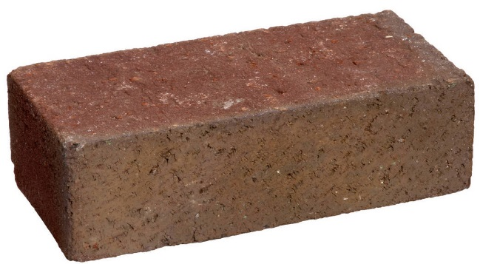
Entrance Question
What are the differences between solids, liquids, and gases?
http://www.youtube.com/watch?v=KCL8zqjXbME

Slide 3
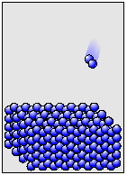
Solids
Solids have a definite shape.
Solids have a definite volume.
The particles of a solid are close together and tightly packed.
The particles of a solid move very little.

Slide 4
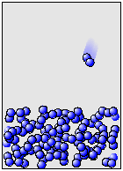
Liquids
Liquids have no definite shape.
They take the shape of their container.
Liquids have a definite volume.
The particles of a liquid are fairly close together.
The particles of a liquid move fairly slowly.

Slide 5
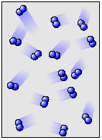
Gases
Gases have no definite shape.
They take the shape of their container.
Gases have no definite volume.
They fill the volume of their container.
The particles of a gas are spread far apart.
The particles of a gas are moving very quickly in all directions.

Slide 6
Change in States
In order for matter to change from one state to another, thermal energy must be added or removed.
A change in states always involves a change in temperature.
As temperature rises, matter changes to a more active state.
https://phet.colorado.edu/en/simulation/states-of-matter-basics

Slide 7
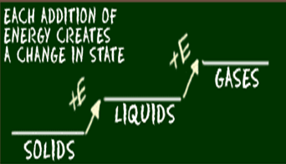
Change in States

Slide 8
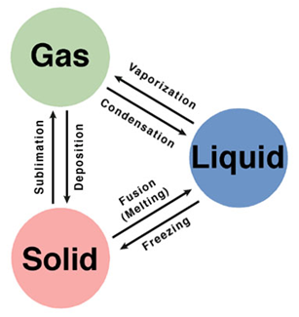
Name each process…

Slide 9
Fun with States of Matter
https://www.youtube.com/watch?v=Fum9Ahvfzq8

Slide 10
Extra Time?
http://www.youtube.com/watch?v=iRgianWtn7o

