Slide 1
Pre-Test
Turn in Homework
Sign if you do not have 3 of the 4 sides completed.
Split a piece of notebook paper with a neighbor.
Put your name, class period, and date at the top.
Number the half-sheet of paper 1-5.

Slide 2
Pre-Test
1.) Which of the following is a group of cells working together to perform a task?
a) organ
b) cell
c) tissue
d) organ system

Slide 3
Pre-Test
2.) Which of the following best classifies the heart?
a) organ
b) cell
c) tissue
d) organ system

Slide 4
Pre-Test
3.) Which of the following is a group of tissues working together to perform a task?
a) organ
b) cell
c) tissue
d) organ system

Slide 5
Pre-Test
4.) Which of the following best describes the levels of organization in a multicellular organism?
a) tissue, cell, organ, organ system
b) organ, organ system, tissue, cell
c) cell, tissue, organ, organ system
d) cell, organ, organ system, tissue

Slide 6
Pre-Test
5.) Which of the following best classifies blood?
a) organ
b) cell
c) tissue
d) organ system

Slide 7
Pre-Test Grading
Trade with your table partner.

Slide 8
Pre-Test Grading
1.) C
2.) A
3.) A
4.) C
5.) C

Slide 9
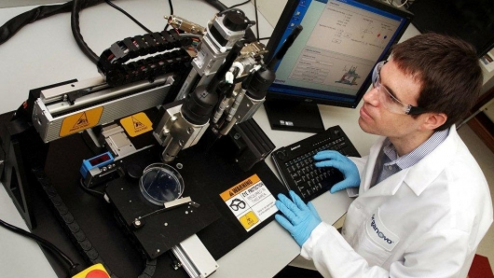
BIOPRINTING

Slide 10
BIOPRINTING
http://www.youtube.com/watch?v=HhbViORMop0

Slide 11
Entrance Question
Last Night’s Homework
-Pull out last night’s homework along with a red pen.
-If you already turned in your homework, go find it in the tray.
-If you did not complete your homework, sign at the board.
Why were bioengineers forced to focus their efforts on printing cells such as bacteria before printing organs such as the bladder?

Slide 12
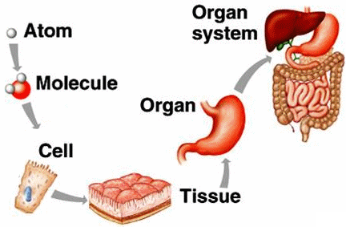
Tissues, Organs, and Systems

Slide 13
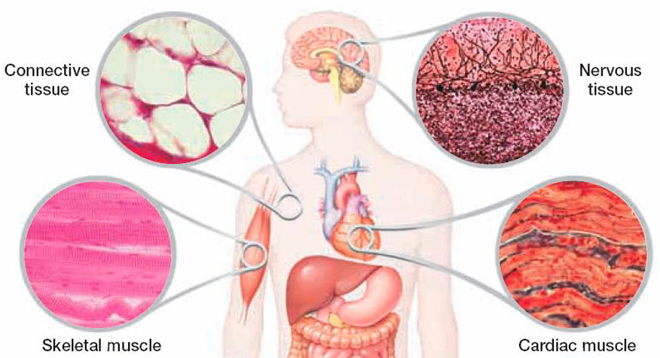
Tissue

Slide 14
Tissue
Groups of cells that work together to do a specific job are called tissues.
Your body, like that of many other animals, is made up of several types of tissue.
Blood, for example, is a tissue that includes different kinds of blood cells and platelets in a liquid. This tissue works to move substances throughout your body and protect you from illness.

Slide 15
Tissues
You also have muscle tissue and nerve tissue that work together to move your body.
Cells of the muscle tissue contract or relax to allow your body to move. But this movement does not occur until direction is given by cells of the nervous tissue.

Slide 16
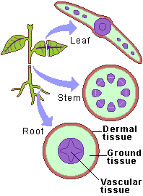
Plant Tissues
Plants have tissues, too.
One tissue moves food around the plant to cells that need it.
Another tissue carries water up from the plant’s roots to its leaves.
Still another plant tissue forms the hard outer covering of trees known as bark. Bark is a tissue that acts as a protective covering for woody plants.

Slide 17
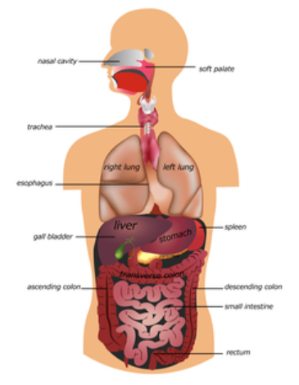
Organs

Slide 18
Organs
Just as cells join together to form tissues, different tissues join together to form organs.
An organ is a structure made up of two or more tissues that work together to carry out a specific job.

Slide 19
Organs
Your stomach is an organ that is made of several types of tissue.
For example, muscle tissue allows your stomach to churn and grind food.
A tissue that lines your stomach produces chemicals that help break down and digest food.

Slide 20
Plant Organs
Roots, stems, and leaves are three organs found in many plants.
Roots have three main roles: to absorb water and dissolved minerals, to support and anchor a plant, and to store extra food made by the plant.
The different tissues that make up a root carry out these jobs.

Slide 21
Plant Organs
Other tissues in a plant join together to form leaves.
Some of these tissues are specialized to make food.
Others are specialized to allow gases to move into and out of the leaf.

Slide 22
Plant Organs

Slide 23
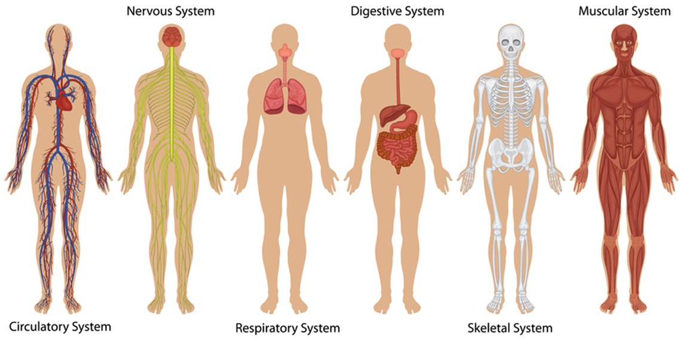
Organ Systems

Slide 24
Organ Systems
Organs do not usually work alone. Instead, several organs work together as an organ system.
An organ system is made up of all organs that work together to do a specific job.

Slide 25
Organ Systems
One example of an organ system is your digestive system.
In this system, your stomach works with your liver, small and large intestines, and other organs to break down food into substances your cells can use.

Slide 26
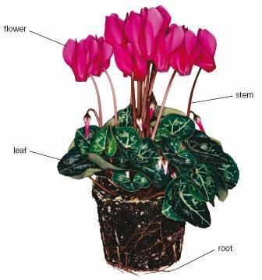
Plant Organ Systems
A plant’s leaves, stems, and roots work together to make, transport, and store food.

Slide 27
Recap
At each level of organization, cells depend on other cells to keep the system running smoothly.

Slide 28
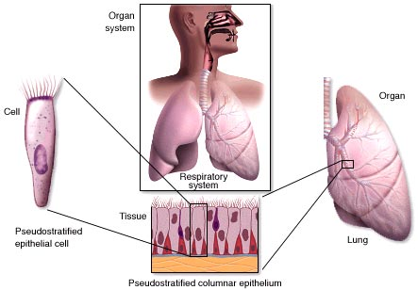
http://www.youtube.com/watch?v=ZRFykdf4kDc
2 min.

Slide 29
http://www.youtube.com/watch?v=8bzCVSPG6l4
9 min.

