Slide 1
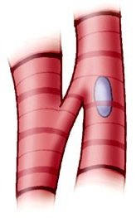
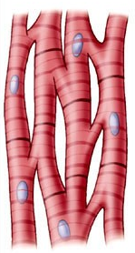
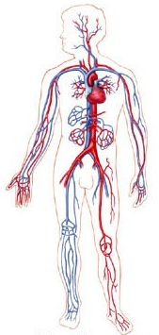
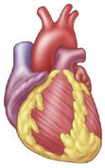
Human Organ Systems Projects
Project Goals:
I can explain the levels in which multicellular organisms are organized.
I can name my assigned organ system and its function(s).
I can identify the major organs/parts present in my assigned organ system and their function(s).

Slide 2
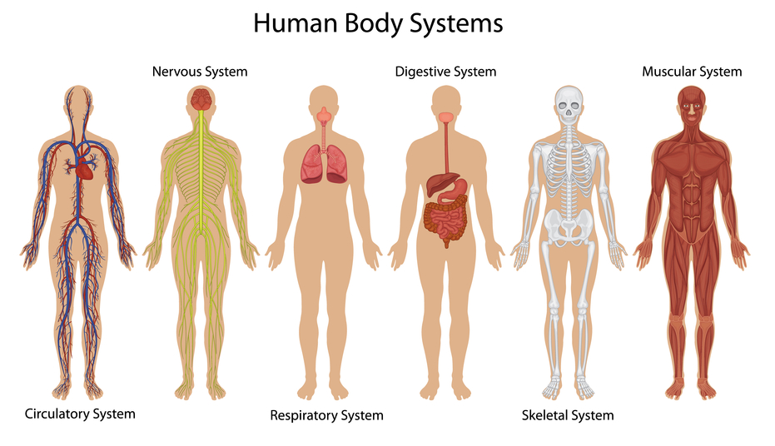

Slide 3
The Process
Review rubric
Organ system selection
Research
Resource List
Fact sheet
Organizer
Report rough draft
Peer review/edit
Report final draft

Slide 4
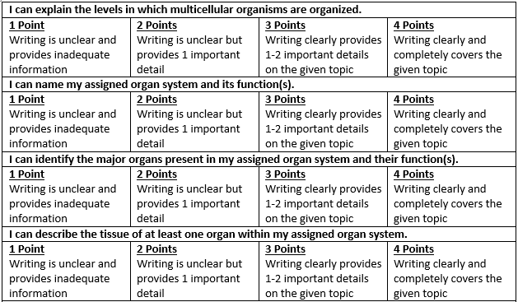

Slide 6
The Process
Review rubric
Organ system selection
Research
Resource List
Fact sheet
Organizer
Report rough draft
Peer review/edit
Report final draft

Slide 7
Resources
All Systems: ScienceSaurus Books
Circulatory System:
http://kidshealth.org/kid/htbw/heart.html
http://www.factmonster.com/dk/science/encyclopedia/circulatory-system.html
Nervous System:
http://kidshealth.org/kid/htbw/brain.html
http://www.biology4kids.com/files/systems_nervous.html
Respiratory System:
http://kidshealth.org/kid/htbw/lungs.html
http://www.biology4kids.com/files/systems_respiratory.html
Skeletal System:
http://www.biology4kids.com/files/systems_skeletal.html
http://www.factmonster.com/dk/science/encyclopedia/skeletal-system.html
Digestive System:
http://kidshealth.org/kid/htbw/digestive_system.html
http://www.biology4kids.com/files/systems_digestive.html
Muscular System:
http://kidshealth.org/kid/htbw/muscles.html
http://www.biology4kids.com/files/systems_muscular.html

Slide 8
3rd Period
Windows
Computers
Front Board

Slide 9
Today
Complete your paragraph organizer.
Remember: Complete sentences in your own words.
Transfer your work onto a piece of notebook paper as your rough draft.
Remember: Skip lines and be sure that your work is in your own words.
Homework: Finish Organizer & Rough Draft
Tomorrow
Mrs. Burchfield will present information about scheduling.
Self-Check

Slide 10
4th Period
Windows
Computers
Front Board

Slide 11
Today
Complete your paragraph organizer.
Remember: Complete sentences in your own words.
Transfer your work onto a piece of notebook paper as your rough draft.
Remember: Skip lines and be sure that your work is in your own words.
Homework: Finish Organizer & Rough Draft
Tomorrow
Mrs. Burchfield will present information about scheduling.
Self-Check

Slide 12
5th Period
Windows
Computers
Front Board

Slide 13
Today
Complete your paragraph organizer.
Remember: Complete sentences in your own words.
Transfer your work onto a piece of notebook paper as your rough draft.
Remember: Skip lines and be sure that your work is in your own words.
Homework: Finish Organizer & Rough Draft
Tomorrow
Mrs. Burchfield will present information about scheduling.
Self-Check

Slide 14
6th Period
Windows
Computers
Front Board

Slide 15
Today
Complete your paragraph organizer.
Remember: Complete sentences in your own words.
Transfer your work onto a piece of notebook paper as your rough draft.
Remember: Skip lines and be sure that your work is in your own words.
Homework: Finish Organizer & Rough Draft
Tomorrow
Mrs. Burchfield will present information about scheduling.
Self-Check

Slide 16
7th Period
Windows
Computers
Front Board

Slide 17
Today
Complete your paragraph organizer.
Remember: Complete sentences in your own words.
Transfer your work onto a piece of notebook paper as your rough draft.
Remember: Skip lines and be sure that your work is in your own words.
Homework: Finish Organizer & Rough Draft
Tomorrow
Mrs. Burchfield will present information about scheduling.
Self-Check

Slide 18
8th Period
Windows
Computers
Front Board

Slide 19
Today
Complete your paragraph organizer.
Remember: Complete sentences in your own words.
Transfer your work onto a piece of notebook paper as your rough draft.
Remember: Skip lines and be sure that your work is in your own words.
Homework: Finish Organizer & Rough Draft
Tomorrow
Mrs. Burchfield will present information about scheduling.
Self-Check

Slide 20
Entrance Question
Skeletal System Question:
Do you believe bones are weaker or stronger than steel? Explain your answer.
http://www.youtube.com/watch?v=FlATeMqTH2g

Slide 21
Peer Review

