Slide 1
Today’s Reading
Step 1: Skim through the entire passage. Look for main ideas.
Step 2: Read the passage as a class. Highlight main ideas.
Step 3: Complete the questions on your own.
Step 4: Review answers as a class.

Slide 2
Let’s Recap KE and PE…
http://www.youtube.com/watch?v=vl4g7T5gw1M&feature=related

Slide 3
Skate Park Simulation
http://phet.colorado.edu/en/simulation/energy-skate-park

Slide 4
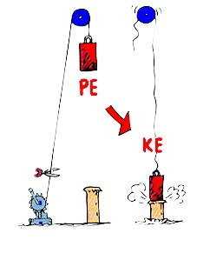
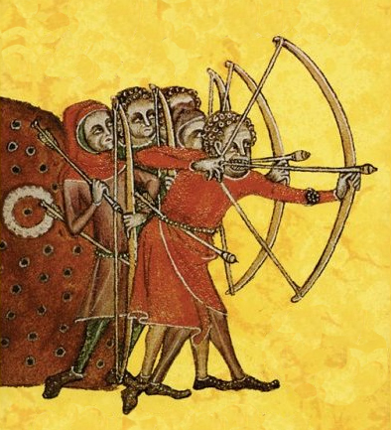
Entrance Question
Explain the energy involved in the two images.
Be sure to include kinetic energy and potential energy in your answer.

Slide 5
Gravitational Potential Energy
What is the difference between potential energy (PE) and gravitational potential energy (GPE)?

Slide 6
Gravitational Potential Energy
Definition:
the energy an object possesses because of its position in a gravitational force field

Slide 7
Gravitational Potential Energy
What two factors affect an object’s GPE?

Slide 8
Gravitational Potential Energy
How could we test this to be sure?
Materials:
Hollow plastic egg, pennies, open container of sand, meter sticks

Slide 9
Variable: Height
Mass of Egg (g) | Drop Height (cm) | Diameter of Crater (cm)

Slide 10
Variable: Mass
Mass of Egg (g) | Drop Height (cm) | Diameter of Crater (cm)

Slide 11
In your notes…
Gravitational Potential Energy
Definition: the energy an object possesses because of its position in a gravitational force field
Factors Affecting GPE:
Height: the greater the height, the more GPE the object will have
Mass: the greater the mass, the more GPE the object will have

Slide 12
Entrance Question
Why do engineers design the beginning of most roller coasters the same way? Use the terms below in your response.
kinetic energy & potential energy
http://www.youtube.com/watch?v=yOTgWr0J1Bw

Slide 13
Marble Track Lab
Materials:
Pencil
Two coloring utensils (colored pencils or highlighters)
Marble Track Lab handout
Expectations:
Collaborate respectfully - Stay on task
Be creative - Use the materials appropriately
Follow directions carefully - Wait patiently at checkpoints

Slide 14
Marble Track Lab
Greens: Back of the room Yellows: Front of the room

Slide 15
Marble Track Lab
Materials:
Pencil
Two coloring utensils (colored pencils or highlighters)
Marble Track Lab handout
Expectations:
Collaborate respectfully - Stay on task
Be creative - Use the materials appropriately
Follow directions carefully - Wait patiently at checkpoints

