Slide 1
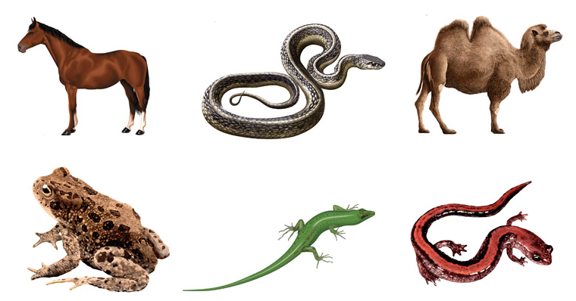
Entrance Question
Place the following organisms into groups. Be prepared to explain the reasoning behind your decisions.
1
2
3
4
6
5

Slide 2
Entrance Question
Place the following organisms into groups. Be prepared to explain the reasoning behind your decisions.
Reptiles
Mammals
1
2
3
4
Amphibians
6
5

Slide 3
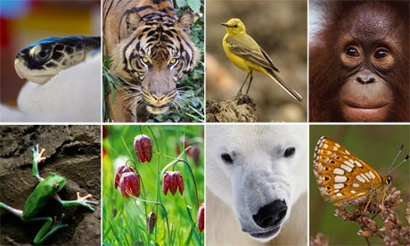
Biodiversity

Slide 4
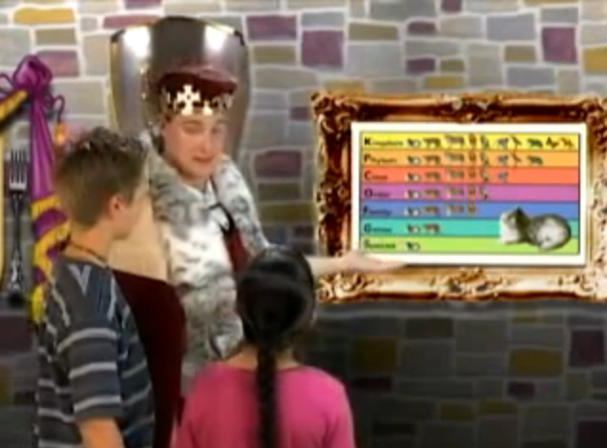
Classification of Living Things
http://www.youtube.com/watch?v=g7WrJGaBegk

Slide 5
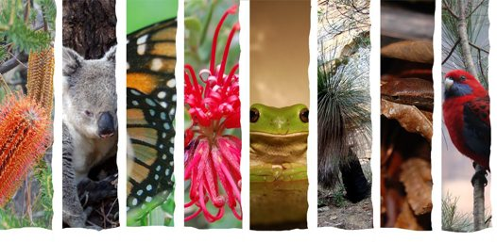
Biodiversity
Organisms have diverse body plans, symmetry, and internal structures that contribute to their being able to survive in their environments.
Diverse – showing variety; very different

Slide 6
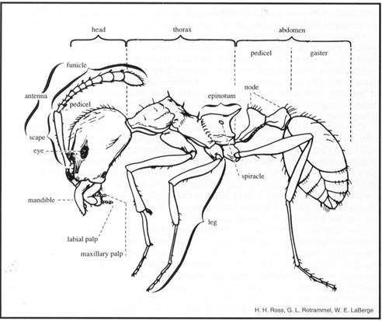
Body Plans
A group of structural and developmental characteristics that can be used to identify a group of organisms
Examples:
    Organisms with backbones vs. organisms without backbones
    Organism with hard shells vs. soft bodies
    Organisms with four body segments and eight legs

Slide 7
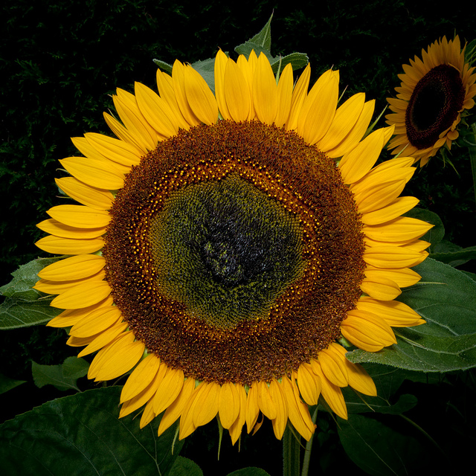
Symmetry
Symmetrical – balanced, both sides are equal to each other
Radial Symmetry – organisms have no top or bottom; can be split in half at any angle to make equal sides (Examples: flowers, jellyfish, and corals)

Slide 8
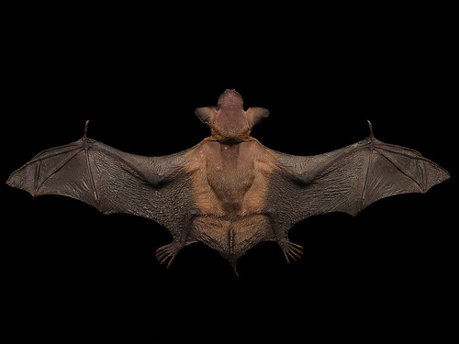
Symmetry
Bilateral Symmetry – organisms can be divided from “head” to “tail” to make equal right and left sides (Examples: humans, butterflies, frogs, etc.)

Slide 9
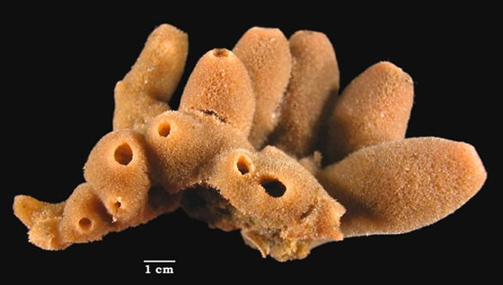
Symmetry
Asymmetrical – unbalanced; neither side is equal to each other (Example: sponges)

Slide 10
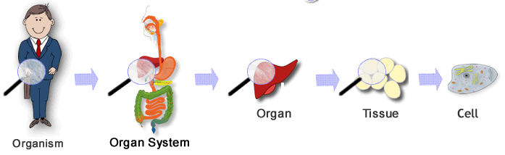
Internal Structures
Organisms show diversity in their levels of organization (cells, tissues, organs, organ systems)

Slide 11
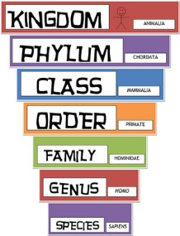
Classification

Slide 12
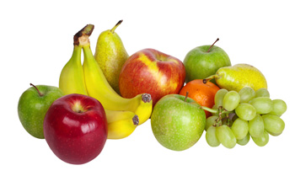
What is classification?
To put things into groups of some kind.
It is usually done based on some type of similarities.

Slide 13

Why do we classify?
Grouping things helps us to understand them better.
Examples: A phone book, a dictionary, a store

Slide 14
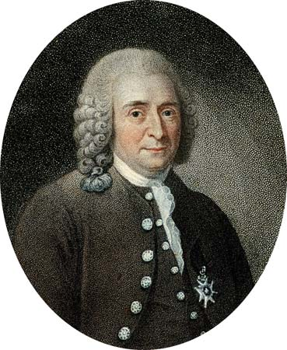
Carolus Linnaeus
Carolus Linnaeus is responsible for developing the classification system we use today (taxonomy).
Linnaeus developed the classification hierarchy.

Slide 15
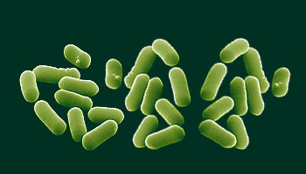
Classification Hierarchy
Kingdom – Highest level; most general
There are five Kingdoms
Kingdom Monera
Members include bacteria and cyanobacteria (blue- green algae) without a nucleus

Slide 16
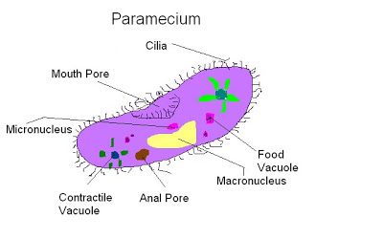
Classification Hierarchy
Kingdom Protista
Other unicellular organisms with a nucleus (more complex)

Slide 17
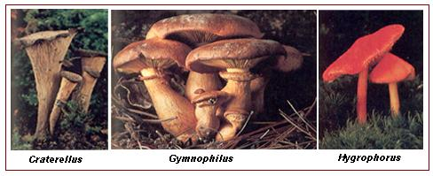
Classification Hierarchy
Kingdom Fungi
Members include mushrooms and mold

Slide 18
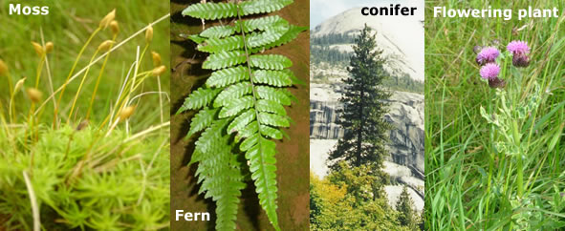
Classification Hierarchy
Kingdom Plantae
Make own food through photosynthesis

Slide 19
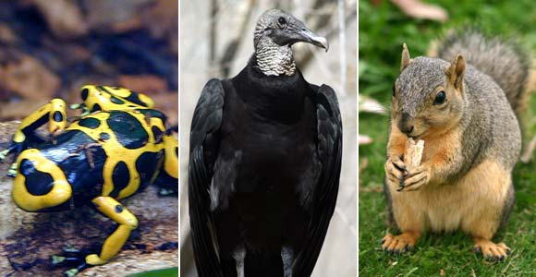
Classification Hierarchy
Kingdom Animalia
Members are multi–cellular, no cell walls, don’t make food through photosynthesis

Slide 20
Classification Hierarchy
Phylum – Groups of classes with shared characteristics; members of a phylum share a common structure and organization
Example: Chordate Phylum (animals with backbones).

Slide 21
Classification Hierarchy
Class – Members share common structure
Example: Class Mammalia (have hair)

Slide 22
Classification Hierarchy
Order – Share common structure and traits
Example: Order Primate (flexible hands and feet)

Slide 23
Classification Hierarchy
Family – Share common characteristics
Example: Family Homindae (bipedal – walks on two feet)

Slide 24
Classification Hierarchy
Genus – Have common characteristics, structures, and organization
Example: Genus Homo (large brain).

Slide 25
Classification Hierarchy
Species – Most basic; members resemble each other
Example: Sapiens (knowing, knowledge, thinking).

Slide 26
Classification Hierarchy
How can you remember each level of the classification hierarchy?
King Phillip Came Over For Good Spaghetti.
King K Kingdom
Phillip P Phylum
Came C Class
Over O Order
For F Family
Good G Genus
Spaghetti S Species

Slide 27
Scientific Names
The scientific name for human beings is Homo sapiens.
Homo – Latin for “man.”
Sapiens – Latin for “wise; to be wise.”
Homo sapiens – The Wise Man
All scientific names are given in Latin.
This is because Latin does not change.
All names are unique for each species.
By using a scientific name, you know exactly which species you are talking about.

Slide 28
Scientific Names
The scientific name also tells you which species are similar.
Which of these three species are similar:
A) Erithacus johnstoniae
B) Turdus migratorius
C) Erithacus rubecula
Correct Answer: Erithacus johnstoniae and Erithacus rubecula
Why does this make sense?
They both fall under the category (genus) of songbirds.

Slide 29

How do we go about classifying things?
Living things are classified based on observable properties
Examples of observable properties:
Living, once living, non-living
External structure – hard or soft
Patterns – geometric shapes, symmetry, etc.

Slide 30
How would you identify an unknown organism?
Get a book, look at all the pictures, and select the one that most looks like the picture?
No!
Use a classification key (also called a dichotomous key).
A classification key asks a question and gives you two answers.

Slide 31
Using a Dichotomous Key

Slide 32
Using a Dichotomous Key
1a. This organism has an exoskeleton - go to question 2 1b. This organism has an endoskeleton or no skeleton - go to question 3
2a. This organism has thin black body and a red stripe on its abdomen - go to question 4a. 2b. This organism has a thick black body with large grey/brown abdomen - go to question 4b.
3a. Organism dwells on land - go to question 5 3b. Organism dwells in the ocean - go to question 6
4a. Organism is called Latrodectus hasselti 4b. Organism is called Atrax infensus
5a. Organism is totally covered in smooth scale-like skin - go to question 7 5b. Organism has a textured coat or covering - go to question 8
6a. Organism 8 thick legs or tentacles - go to question 9a. 6b. Has many string-like legs or tentacles - go to question 9b.
7a. Scale-like skin is patterned in horizontal stripes over the body - go to question 10a. 7b. Scale-like skin has one block color over most of its body - go to question 10b.
8a. Has fine fur-like covering - go to question 11 8b. Has feather-like covering over most of its body - go to question 12
9a. Organism is Hapalochlaena lunulata 9b. Organism is Chironex flecken
10a. Organism is Psuedonaja texilis 10b. Organism is Pseudechis porphyricus
11a. Has two opposing thumbs on the front paws - go to question 13a. 11b. Has no opposing thumb on the front paws - go to question 13b.
12a. Has large bone-like structure on a bald, blue-skinned head - got to question 14a. 12b. Has feather-like covering over head with no bone-like structure - go to question 14b.
13a. Organism is Phascolatarctos cinerus 13b. Organism is Vombatus ursinus
14a. Organism is Casuarius casuarius 14b. Organism is Dromaius novaebollandiae

Slide 33
Using a Dichotomous Key
1a. This organism has an exoskeleton - go to question 2 1b. This organism has an endoskeleton or no skeleton - go to question 3
2a. This organism has thin black body and a red stripe on its abdomen - go to question 4a. 2b. This organism has a thick black body with large grey/brown abdomen - go to question 4b.
3a. Organism dwells on land - go to question 5 3b. Organism dwells in the ocean - go to question 6
4a. Organism is called Latrodectus hasselti 4b. Organism is called Atrax infensus
5a. Organism is totally covered in smooth scale-like skin - go to question 7 5b. Organism has a textured coat or covering - go to question 8
6a. Organism 8 thick legs or tentacles - go to question 9a. 6b. Has many string-like legs or tentacles - go to question 9b.
7a. Scale-like skin is patterned in horizontal stripes over the body - go to question 10a. 7b. Scale-like skin has one block color over most of its body - go to question 10b.
8a. Has fine fur-like covering - go to question 11 8b. Has feather-like covering over most of its body - go to question 12
9a. Organism is Hapalochlaena lunulata 9b. Organism is Chironex flecken
10a. Organism is Psuedonaja texilis 10b. Organism is Pseudechis porphyricus
11a. Has two opposing thumbs on the front paws - go to question 13a. 11b. Has no opposing thumb on the front paws - go to question 13b.
12a. Has large bone-like structure on a bald, blue-skinned head - got to question 14a. 12b. Has feather-like covering over head with no bone-like structure - go to question 14b.
13a. Organism is Phascolatarctos cinerus 13b. Organism is Vombatus ursinus
14a. Organism is Casuarius casuarius 14b. Organism is Dromaius novaebollandiae

Slide 34
Using a Dichotomous Key
1a. This organism has an exoskeleton - go to question 2 1b. This organism has an endoskeleton or no skeleton - go to question 3
2a. This organism has thin black body and a red stripe on its abdomen - go to question 4a. 2b. This organism has a thick black body with large grey/brown abdomen - go to question 4b.
3a. Organism dwells on land - go to question 5 3b. Organism dwells in the ocean - go to question 6
4a. Organism is called Latrodectus hasselti 4b. Organism is called Atrax infensus
5a. Organism is totally covered in smooth scale-like skin - go to question 7 5b. Organism has a textured coat or covering - go to question 8
6a. Organism 8 thick legs or tentacles - go to question 9a. 6b. Has many string-like legs or tentacles - go to question 9b.
7a. Scale-like skin is patterned in horizontal stripes over the body - go to question 10a. 7b. Scale-like skin has one block color over most of its body - go to question 10b.
8a. Has fine fur-like covering - go to question 11 8b. Has feather-like covering over most of its body - go to question 12
9a. Organism is Hapalochlaena lunulata 9b. Organism is Chironex flecken
10a. Organism is Psuedonaja texilis 10b. Organism is Pseudechis porphyricus
11a. Has two opposing thumbs on the front paws - go to question 13a. 11b. Has no opposing thumb on the front paws - go to question 13b.
12a. Has large bone-like structure on a bald, blue-skinned head - got to question 14a. 12b. Has feather-like covering over head with no bone-like structure - go to question 14b.
13a. Organism is Phascolatarctos cinerus 13b. Organism is Vombatus ursinus
14a. Organism is Casuarius casuarius 14b. Organism is Dromaius novaebollandiae

Slide 35
Using a Dichotomous Key
1a. This organism has an exoskeleton - go to question 2 1b. This organism has an endoskeleton or no skeleton - go to question 3
2a. This organism has thin black body and a red stripe on its abdomen - go to question 4a. 2b. This organism has a thick black body with large grey/brown abdomen - go to question 4b.
3a. Organism dwells on land - go to question 5 3b. Organism dwells in the ocean - go to question 6
4a. Organism is called Latrodectus hasselti 4b. Organism is called Atrax infensus
5a. Organism is totally covered in smooth scale-like skin - go to question 7 5b. Organism has a textured coat or covering - go to question 8
6a. Organism 8 thick legs or tentacles - go to question 9a. 6b. Has many string-like legs or tentacles - go to question 9b.
7a. Scale-like skin is patterned in horizontal stripes over the body - go to question 10a. 7b. Scale-like skin has one block color over most of its body - go to question 10b.
8a. Has fine fur-like covering - go to question 11 8b. Has feather-like covering over most of its body - go to question 12
9a. Organism is Hapalochlaena lunulata 9b. Organism is Chironex flecken
10a. Organism is Psuedonaja texilis 10b. Organism is Pseudechis porphyricus
11a. Has two opposing thumbs on the front paws - go to question 13a. 11b. Has no opposing thumb on the front paws - go to question 13b.
12a. Has large bone-like structure on a bald, blue-skinned head - got to question 14a. 12b. Has feather-like covering over head with no bone-like structure - go to question 14b.
13a. Organism is Phascolatarctos cinerus 13b. Organism is Vombatus ursinus
14a. Organism is Casuarius casuarius 14b. Organism is Dromaius novaebollandiae

Slide 36
Using a Dichotomous Key
1a. This organism has an exoskeleton - go to question 2 1b. This organism has an endoskeleton or no skeleton - go to question 3
2a. This organism has thin black body and a red stripe on its abdomen - go to question 4a. 2b. This organism has a thick black body with large grey/brown abdomen - go to question 4b.
3a. Organism dwells on land - go to question 5 3b. Organism dwells in the ocean - go to question 6
4a. Organism is called Latrodectus hasselti 4b. Organism is called Atrax infensus
5a. Organism is totally covered in smooth scale-like skin - go to question 7 5b. Organism has a textured coat or covering - go to question 8
6a. Organism 8 thick legs or tentacles - go to question 9a. 6b. Has many string-like legs or tentacles - go to question 9b.
7a. Scale-like skin is patterned in horizontal stripes over the body - go to question 10a. 7b. Scale-like skin has one block color over most of its body - go to question 10b.
8a. Has fine fur-like covering - go to question 11 8b. Has feather-like covering over most of its body - go to question 12
9a. Organism is Hapalochlaena lunulata 9b. Organism is Chironex flecken
10a. Organism is Psuedonaja texilis 10b. Organism is Pseudechis porphyricus
11a. Has two opposing thumbs on the front paws - go to question 13a. 11b. Has no opposing thumb on the front paws - go to question 13b.
12a. Has large bone-like structure on a bald, blue-skinned head - got to question 14a. 12b. Has feather-like covering over head with no bone-like structure - go to question 14b.
13a. Organism is Phascolatarctos cinerus 13b. Organism is Vombatus ursinus
14a. Organism is Casuarius casuarius 14b. Organism is Dromaius novaebollandiae

Slide 37
Using a Dichotomous Key
1a. This organism has an exoskeleton - go to question 2 1b. This organism has an endoskeleton or no skeleton - go to question 3
2a. This organism has thin black body and a red stripe on its abdomen - go to question 4a. 2b. This organism has a thick black body with large grey/brown abdomen - go to question 4b.
3a. Organism dwells on land - go to question 5 3b. Organism dwells in the ocean - go to question 6
4a. Organism is called Latrodectus hasselti 4b. Organism is called Atrax infensus
5a. Organism is totally covered in smooth scale-like skin - go to question 7 5b. Organism has a textured coat or covering - go to question 8
6a. Organism 8 thick legs or tentacles - go to question 9a. 6b. Has many string-like legs or tentacles - go to question 9b.
7a. Scale-like skin is patterned in horizontal stripes over the body - go to question 10a. 7b. Scale-like skin has one block color over most of its body - go to question 10b.
8a. Has fine fur-like covering - go to question 11 8b. Has feather-like covering over most of its body - go to question 12
9a. Organism is Hapalochlaena lunulata 9b. Organism is Chironex flecken
10a. Organism is Psuedonaja texilis 10b. Organism is Pseudechis porphyricus
11a. Has two opposing thumbs on the front paws - go to question 13a. 11b. Has no opposing thumb on the front paws - go to question 13b.
12a. Has large bone-like structure on a bald, blue-skinned head - got to question 14a. 12b. Has feather-like covering over head with no bone-like structure - go to question 14b.
13a. Organism is Phascolatarctos cinerus 13b. Organism is Vombatus ursinus
14a. Organism is Casuarius casuarius 14b. Organism is Dromaius novaebollandiae

Slide 38
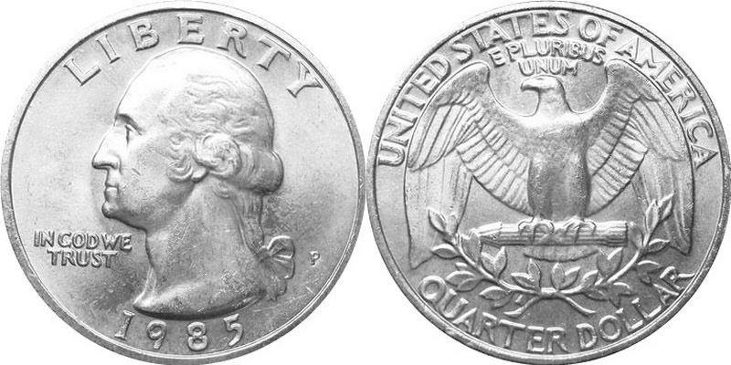
Dichotomous Key Practice Activity 1:
Directions: For this activity, circle the steps taken to reach your final classification.
1 A. Is it made of metal? Go to 2
1 B. Is it made of paper? Go to 5
2 A. It is brown (copper). It is a penny
2 B. It is silver. Go to 3
3 A. It has a smooth edge. It is a nickel.
3 B. It has ridges around the edge. Go to 4
4 A. It has a torch on the back. It is a dime
4 B. It has an eagle on its back. It is a quarter
5 A. It has the number 1 in the corners. It is a $1 bill
5 B. It has the number 2 in the corners. It is a $2 bill

Slide 39
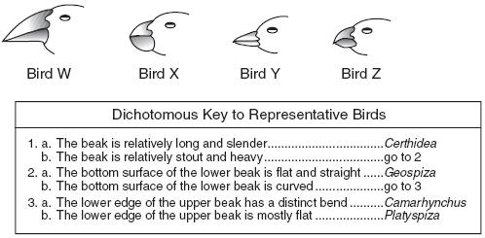
Dichotomous Key Practice Activity 2:
Directions: Use the key below to classify ALL birds.

Slide 40
Entrance Question
Vertebrates are organisms with backbones.
Invertebrates are organisms without backbones.
Part A) Finish this sentence:
Vertebrates and invertebrates have diverse ______________.
A) body plans OR B) internal structures
Part B) What is the difference between body plan and internal structure?

Slide 41
Review Question
Which level of the classification system is missing?
Class
Phylum
Order
Species
Genus
Kingdom
Family

Slide 42
Review Question
Which of the following levels is the LEAST specific?
Class
Family
Genus

Slide 43
Review Question
Which of the following levels is the LEAST specific?
Class
Family
Genus

Slide 44
Review Question
Put the levels of the classication system in the correct order.
(Least specific to most specific)
Class
Phylum
Order
Species
Genus
Kingdom
Family

Slide 45
Pull out last night’s homework.

Slide 46
Dichotomous Key Practice

Slide 47
Tuesday’s Quiz
Learning Targets:
I can explain the levels in which multicellular organisms are organized.
  Tissues, Organs, and Systems Notes
  Organ Systems Information Table
I can describe the ways in which living organisms are diverse.
I can classify organisms by their observable properties.
  Biodiversity/Classification Notes
  Dichotomous Key Worksheets

