Slide 1
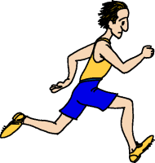
Entrance Question
Bob and Bill decide to race each other. The results show that Bill had more speed than Bob.
What does it mean to have more speed?
You may NOT use the words fast or slow in your response.

Slide 2
How is speed calculated?
Speed helps us describe an object’s motion.

Slide 3
Tracy takes her new car out on the highway. Once on the highway she sets her cruise control and drives on the highway for 65 miles. She was on the highway for 1 hour. What was Tracy’s speed on the highway?

Slide 4
Tracy takes her new car out on the highway. Once on the highway she sets her cruise control and drives on the highway for 248 miles. She was on the highway for 4 hours. What was Tracy’s speed on the highway?

Slide 5
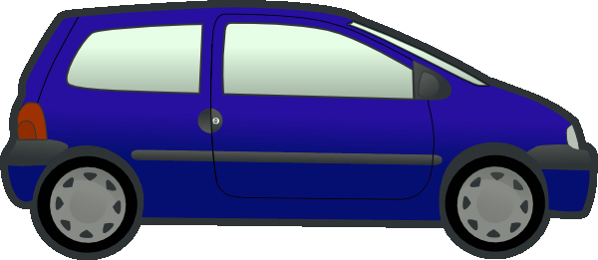
Steve also takes his new car out on the highway. Once on the highway he sets his cruise control and drives on the highway for 364 miles. He was on the highway for 7 hours. What was Steve’s speed on the highway?

Slide 6
Bill runs 1,600 meters in 8 minutes. What is Bill’s speed?

Slide 7
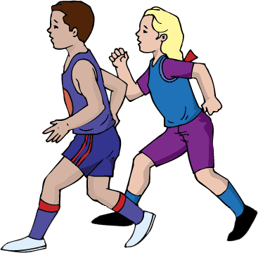
Jared ran 800 meters in 5 minutes.
Jennifer ran 1,200 meters in 8 minutes.
Who had the greater speed?

Slide 8
Open your books to page B86…

Slide 9
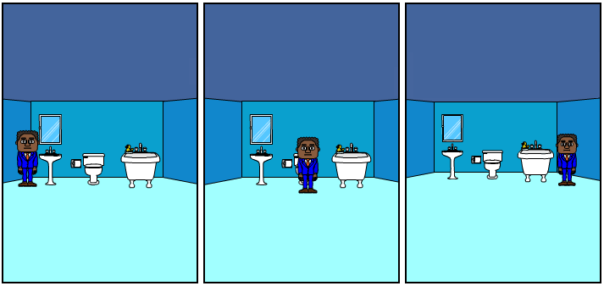
Entrance Question
Describe the motion, if any, in the three frames below.

Slide 10
Pg. B93 Lesson 2 Review
What are the three types of motion?
The three types of motion are vibrational (back and forth), circular (motion around a central point), and straight-line (straight path).

Slide 11
Pg. B93 Lesson 2 Review
2. What is distance and displacement?
Distance is the total path traveled between two points. Displacement is a straight-line distance and direction from one point to another.

Slide 12
Pg. B93 Lesson 2 Review
3. What is the difference between speed and velocity?
Speed is the distance an object moves during a period of time and velocity is a measure of speed in a given direction.

Slide 13
Pg. B93 Lesson 2 Review
4. What are the three ways an object can accelerate?
It can speed up, slow down, or change direction.

Slide 14
Pg. B93 Lesson 2 Review
5. Suppose the path of racers on page B92 goes uphill
at some point. What effect will that most likely have
on their velocity?
The velocity will change because their direction changes – they go up. Their speed will most likely decrease.

Slide 15
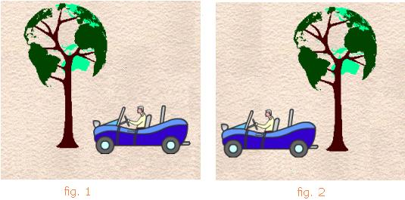
Motion
relative motion
An object’s ____________________________ is the change in position of one object compared to the position of another object.
The object an observer uses to detect motion is called a _______________________ or _______________________________.
frame of reference
reference point

Slide 16
Speed
Speed
______________ is the distance an object moves in a certain period of time.
You can figure out an object’s speed if you know the _______________ it traveled and the _______________ it took.
Speed =
distance
time
distance
time

Slide 17
Speed
50
A car travels 350 miles in 7 hours The car’s speed is _________ miles/hour.
The car’s speed probably wasn’t the same throughout the drive, therefore its ______________________ was 50 miles/hour.
If a car sets its cruise control to 55 miles/hour, it is traveling at a ____________________ because its speed is constant.
Any speed that is not constant involves _______________________, or a change in velocity (speed and/or direction).
average speed
constant speed
acceleration

Slide 18
Practice
1.) A caterpillar travels at a constant speed for 312 cm. It takes the
caterpillar 6 minutes to travel that distance. What was its speed?
2.) A marble is test on two different tracks. Track A is 256 inches long
and the marble completes the track in 8 seconds. Track B is 297
inches long and the marble completes the track in 9 seconds. On
which track did the marble have the greater speed?
3.) A car is travelling at an average speed of 61 miles per hour for 15
hours. How far did the car travel in that time?

Slide 19
Entrance Question
Mike hit a long fly ball to left field. The left fielder picked up the ball and threw it 125 feet to the third baseman. The ball was in the air for 4 seconds. Then the third baseman relayed the ball to the catcher to make the play at home plate. Home plate was 97 feet away and the ball was in the air for another 3 seconds. Which player threw the ball faster?

Slide 20
Marble Track Speed Lab

Slide 21
Entrance Question

Slide 22
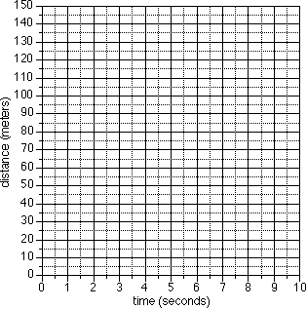
Distance vs. Time Graphs
Constant Speed: Speed remains constant (does not change)
So what if an object moved at a constant speed of…
10 meters/second

Slide 23
Distance vs. Time Graphs
Constant Speed: Speed remains constant (does not change)
So what if an object moved at a constant speed of…
30 meters/second

Slide 24
Distance vs. Time Graphs
Constant Speed: Speed remains constant (does not change)
So what if an object moved at a constant speed of…
15 meters/second

Slide 25
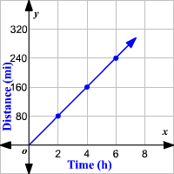
Distance vs. Time Graphs
The graph represents the motion of a car.
Describe the speed(s) of this car.
If another car was travelling 50 mph, how would its line compare?

Slide 26
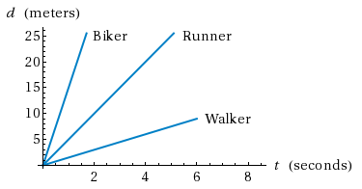
Distance vs. Time Graphs
Which person had the greatest speed? What evidence supports your answer?

Slide 27
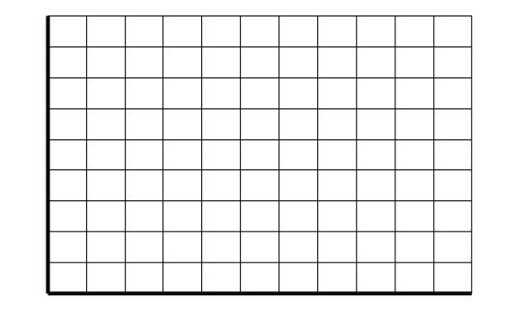
Distance vs. Time Graphs
Describe the motion of the moving object represented in the graph.
Distance (m)
Time (min)

Slide 28
Distance vs. Time Graphs
Describe the motion of the moving object represented in the graph.
Distance (m)
Time (min)

Slide 29
Distance vs. Time Graphs
Describe the motion of the car represented in the graph.
Distance from home (miles)
Time (min)

Slide 30
Distance vs. Time Graphs
Describe the motion of the car represented in the graph.
Distance from school (miles)
Time (min)

Slide 31
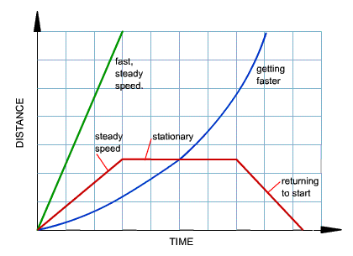
Distance vs. Time Graphs Review

