Slide 1
Entrance Question
When you think of the term cell, write THREE words that come to mind.
Use those three terms to write your best description or definition of cell.
(Write new learning target in LIFE section.)

Slide 2
Entrance Question
What do you think would happen if our cells were not capable of repairing and/or replacing themselves?
Include one scenario in your response.

Slide 3
Cells

Slide 4
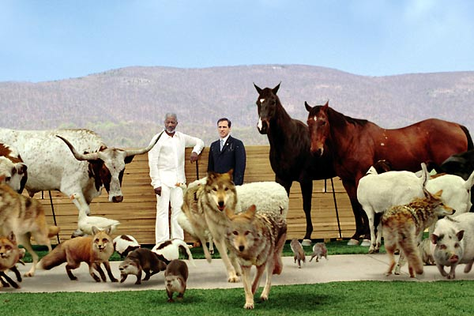
Cells
Modern Cell Theory states that all living things are made of cells.
Cells are the basic unit of structure and function of all living things.

Slide 5
Cells
How did scientists first discover cells?
What did it take to come up with the Cell Theory?

Slide 6
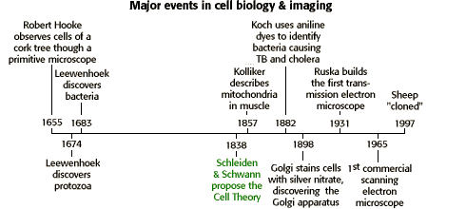
Modern Cell Theory

Slide 7
Single-Celled Organisms
Many organisms are single-celled and that one cell must carry out all the basic functions of life.
Examples of single-celled organisms include: bacteria, algae, and fungi
Most single-celled organisms are of microscopic size and are thus classified as microorganisms.

Slide 8
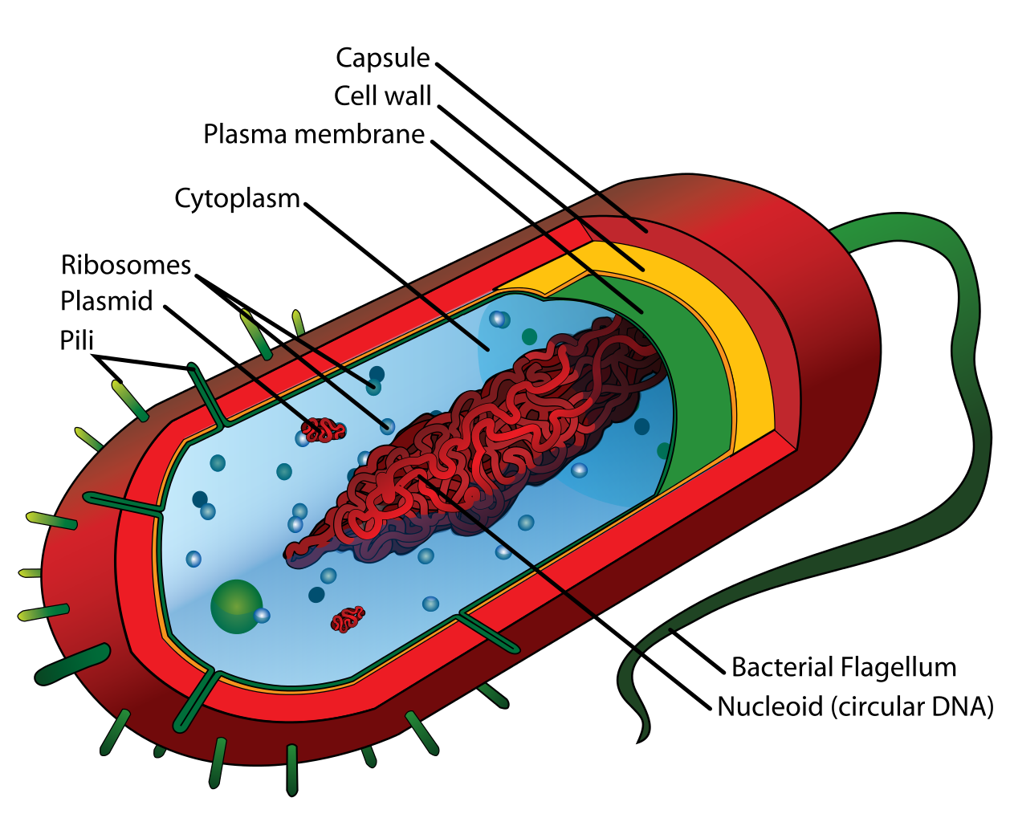
Single-Celled Organisms
Bacteria

Slide 9
Multicellular Organisms
Other organisms are multicellular and the cells that form these organisms can be organized at various levels to carry out all the basic functions of life.
Examples of multi-cellular organisms include: humans, dogs, cats, fish, etc.

Slide 10
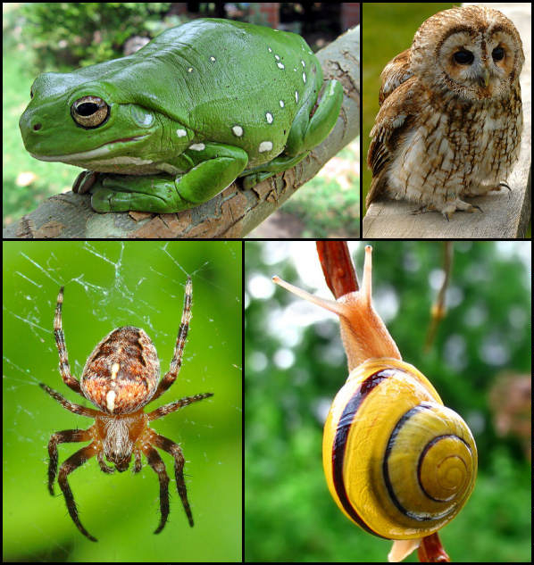
Multicellular Organisms

Slide 11
Multicellular Organisms
Different body tissues and organs can be made up of different kinds of cells.
The cells in similar tissues and organs in animals are similar.

Slide 12
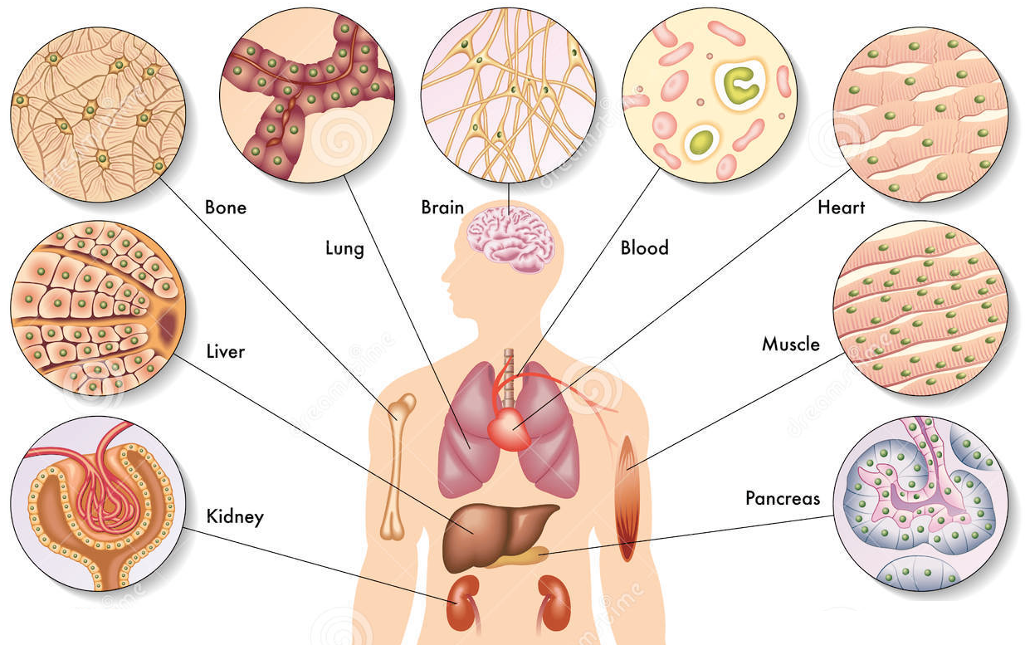
Multicellular Organisms

Slide 13
Multicellular Organisms
The tissues and organs found in plants differ slightly from similar tissues in animals.

Slide 14
Do plants have different organs?

Slide 15
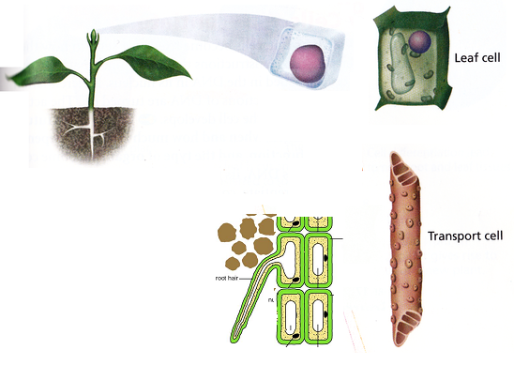
Multicellular Organisms

Slide 16
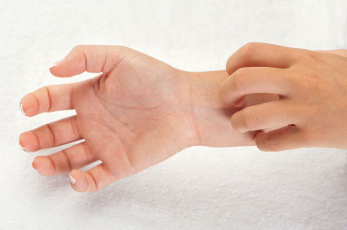
Cellular Reproduction
Modern Cell Theory states that cells come from pre-existing cells.
Individual organisms do not live forever therefore reproduction is necessary for the continuation of every species.

Slide 17
Cellular Reproduction
Traits are passed onto the next generation through reproduction.
Cells have two ways of reproducing: mitosis and meiosis.

Slide 18
Cellular Reproduction: Single-Celled
In single-celled organisms, the process of binary fission produces a new organism.
http://www.youtube.com/watch?v=Th4v_Q1iHfY

Slide 19
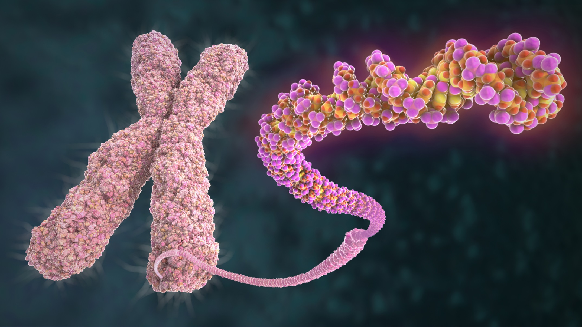
Chromosome?

Slide 20
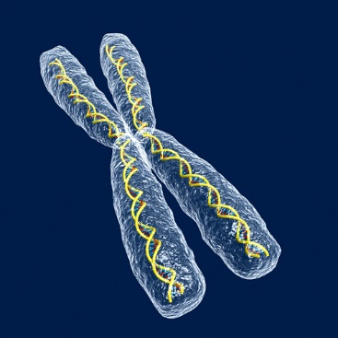
Background on Chromosomes
All cells contain genetic materials.
Chromosomes are structures in cells that contain the genetic material.
Chromosomes are found
within the cell’s nucleus.

Slide 21
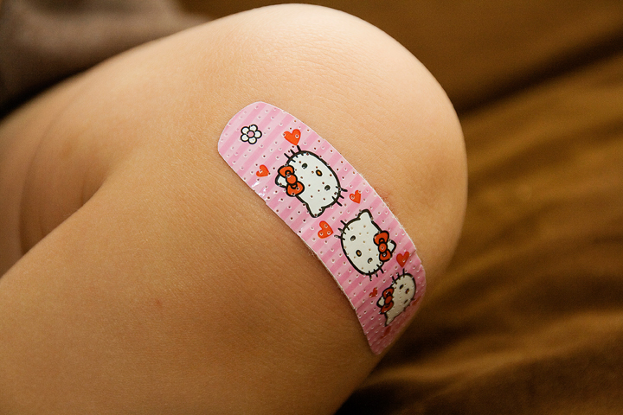
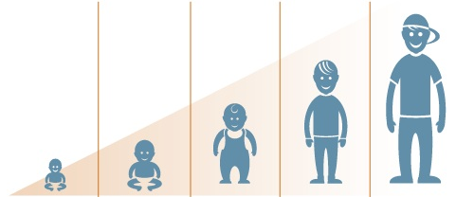
Cellular Reproduction: Multicellular
In multicellular organisms, cells multiply for growth and repair.
Cells multiply by the process of mitosis.

Slide 22
Mitosis
In mitosis, a new copy of a cell is created.
Where there was once one cell, after mitosis there are now two cells.

Slide 23
Mitosis in Four Simple Steps

Slide 24
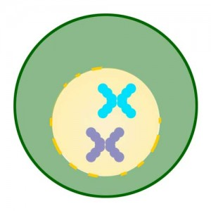
Mitosis
Step One: The original cell duplicates its chromosomes in its nucleus.

Slide 25
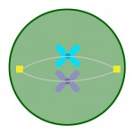
Mitosis
Step Two: The duplicated chromosomes line up.

Slide 26
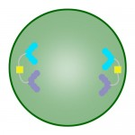
Mitosis
Step Three: The duplicated chromosomes get pulled off into two opposite directions.

Slide 27
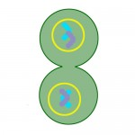
Mitosis
Step Four: A nuclear membrane forms around each separated set of chromosomes and the cell eventually separates into two cells.

Slide 28
Mitosis Overview
The original cell, called the parent cell, no longer exists – it splits itself into two pieces. The two new cells are the daughter cells.
There are always two cells; they are exactly like the parent cell, except smaller.

Slide 29
Mitosis Overview
This process splits everything in the cell. During mitosis, the nucleus makes a copy of every chromosome.
One copy of each chromosome is sent to each daughter cell. That’s how the number of chromosomes remains the same.
http://www.youtube.com/watch?v=gwcwSZIfKlM

